Slide 1
January 22, 2018

Slide 2
Evaluating Stakeholders Committee’ s
Land Use Recommendations
Stakeholders Committee Completed its Draft Land Use Recommendations
Results in:
    Where new residential and non-residential growth may occur
    Provides for type and density of new development (amount)

Slide 3
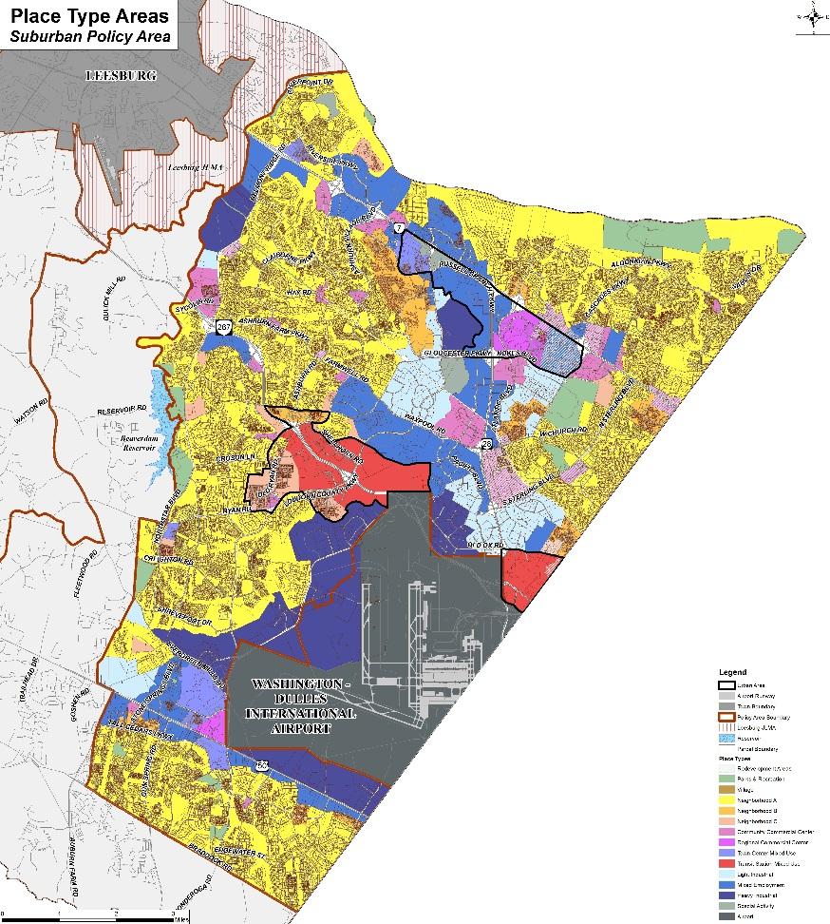
Suburban Policy Area

Slide 4
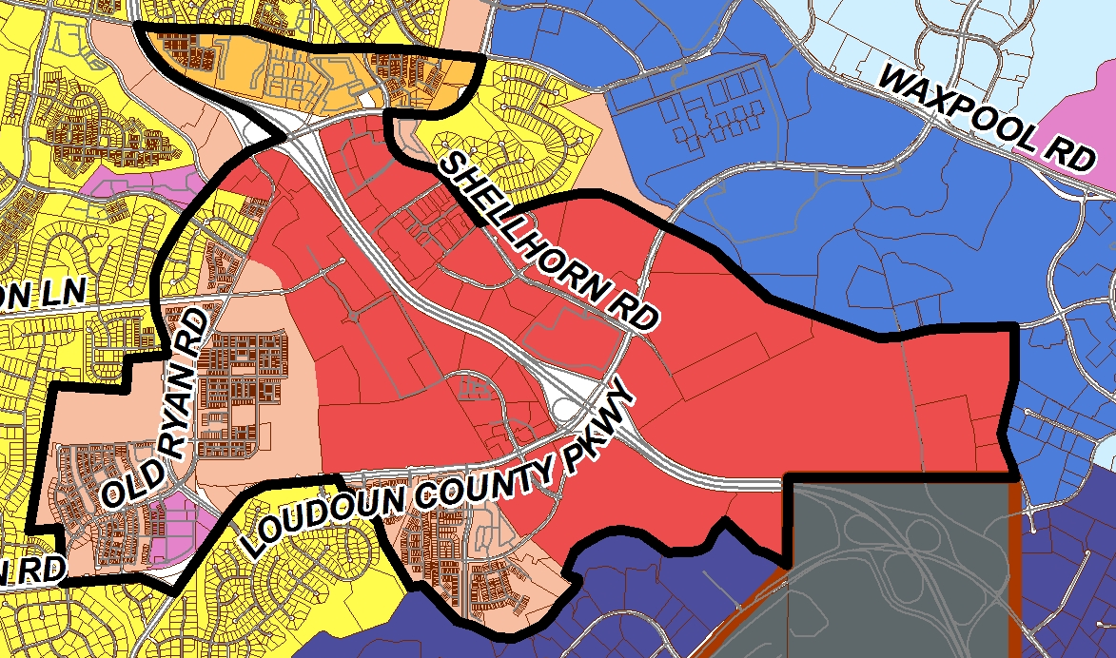
Silver Line Area

Slide 5
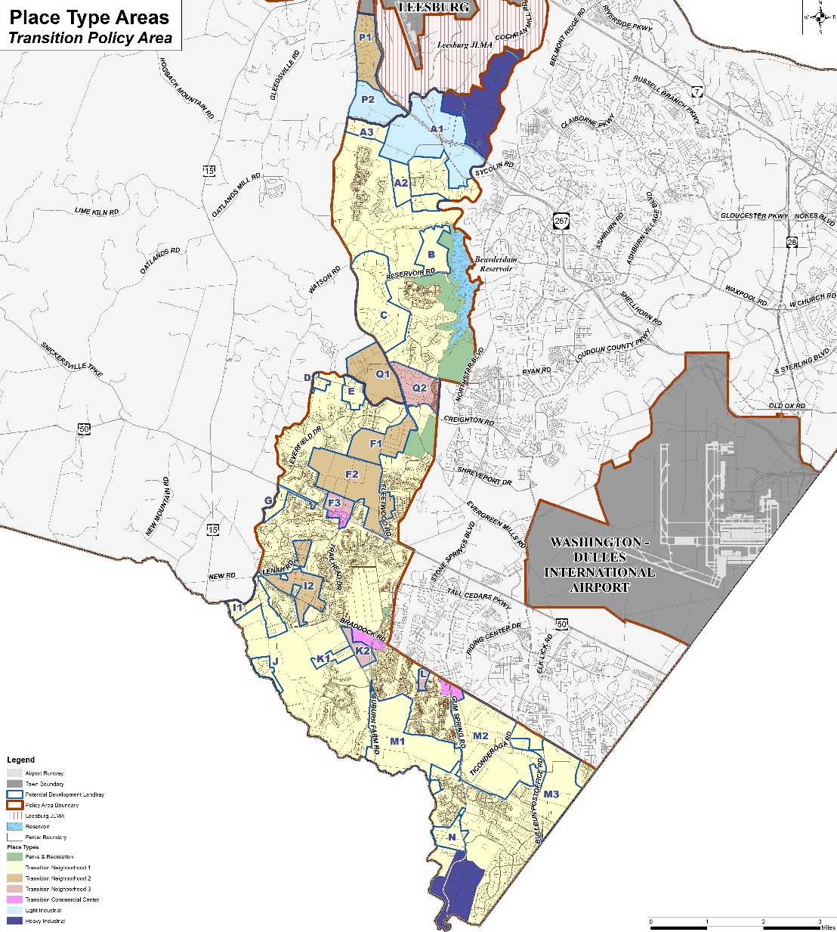

Slide 6
New Growth and Development Above the Revised General Plan
  Impacts – New Facilities Needs
  Revenues and Costs Generated

Slide 7
Modeling of Stakeholders Committee’s Proposed Land Uses
  Fiscal Impact Model – Evaluates Revenues and Costs
  Travel Demand Model – Evaluates and Forecast Transportation Impacts

Slide 8
Information Needed for Modeling
The amount of new growth (number of housing units/square footage of non-residential);
The type of new growth or product type – Single family, town-homes, multi-family, office, data center, commercial, etc.;
The location of the new growth – transition, suburban, specific traffic zone; and
The timing of the new growth – Next 5, 10, 15, & 20 years

Slide 9
Reason For a Market Analysis
Independent assessment by professional market analysts
To gain a broader understanding of national, regional, and local demands that impact Loudoun’s growth potential
To provide a macro-level unconstrained look at future demand for new growth by development type

Slide 10
How will the information be obtained?
Market Analysis is needed to determine:
  Demand – Unconstrained amount of new growth possible
  Trends of Absorption – A market assessment helps determine the absorption trend over time (5,10,15, 20 years)
  Location – Some areas are more desirable for certain types of growth than others
Forecast of New Growth Above the Revised General Plan
  Supply – Constrained amount of new growth possible based on Stakeholders Committee’s Land Use Recommendations (available land and density)

Slide 11
Planning Process
Plan Policies, Strategies & Actions
TESTING
Vision and Goals
Land Use Plan
Constrained
Forecasts
(SUPPLY)
Modeling
Fiscal Impacts
Traffic Demand
Results / Analysis
Foundations
Transportation Plan
Market Analysis
(DEMAND)

