Slide 1
Calibration with Stakeholder Committee’s Land Use Recommendations
January 22, 2018

Slide 2
Calibration Process
Unconstrained Market Forecasts:
DEMAND
Fiscal and Transportation Modeling:
RESULTS
Constrained Forecasts:
SUPPLY
Notes:
BOX 1: Unconstrained Market Forecasts (DEMAND)
Assumes unlimited land availability and no land use considerations
Allocates real estate product types by sector through 2040
BOX 2: Calibration of Market Forecasts with Constraints (SUPPLY)
Apply constraints such as the land use recommendations and availability of land (including consideration of floodplains and other environmental features) to develop constrained forecasts for development potential in 5-year increments through 2040
BOX 3: Fiscal/Transportation Modeling of Preferred Growth Scenario (RESULTS)
Feed the Supply data into the Fiscal and Transportation Models
Fiscal model generates fiscal / public facilities impacts and cost / revenues
Transportation model generates impacts to roadway capacity

Slide 3
Conversion of Place Types to Product Types
Proposed Place Types and Draft Land Use Plan are utilized to determine product types and the mix of product types
Unconstrained Market Forecasts are used to understand potential demand for each product type and absorption trends over time
Notes:
1: Both Residential and Non-Residential
2. Absorption trends are shown in 5-year increments to 2040

Slide 4
Constrained Development Forecasts
Constraints applied to Unconstrained Market Forecasts
  Stakeholders Committee’s Land Use Recommendations
  Available Land Supply
Four growth scenarios developed
  Baseline (Revised General Plan)
  High
  Medium
  Low
Notes:
BULLET 1: Availability of land also includes constraints for floodplain and other environmental features
BULLET 2: Fiscal Model develops impact results for all four growth scenarios (Baseline, High, Medium, Low)
Transportation Model develops results for Baseline and Medium growth scenarios

Slide 5
Allocation of Growth to Geographies
Both residential and non-residential growth is allocated down to specific geographic zones
  Fiscal Area Zones (6 zones)
    Suburban Area
    Transition Area
    Remainder of County (Rural, Towns, JLMA)
    Metrorail Tax District
    Ashburn Station District
    Loudoun Gateway – Airport Station District
  Transportation Area Zones (650+ zones)
Allocate potential growth to appropriate zones
Notes:
Allocation is attributed to the zones where development is expected.

Slide 6
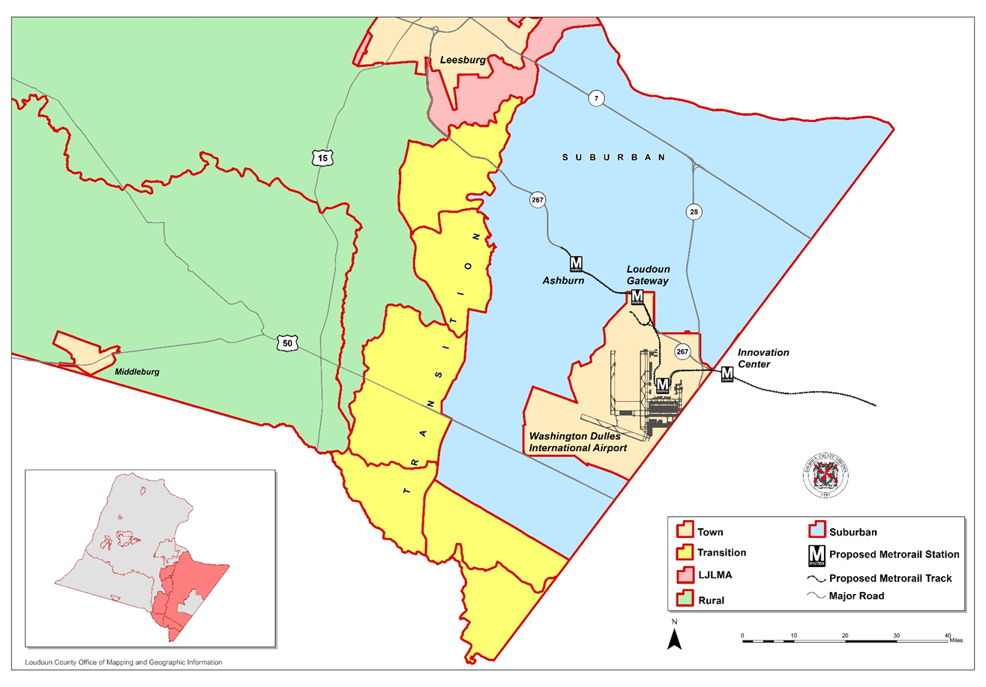
Fiscal Area Zones
Suburban
Transition
Remainder of County (Rural, Towns, JLMA)
Notes:
Allocation is attributed to the zones where development is expected.

Slide 7
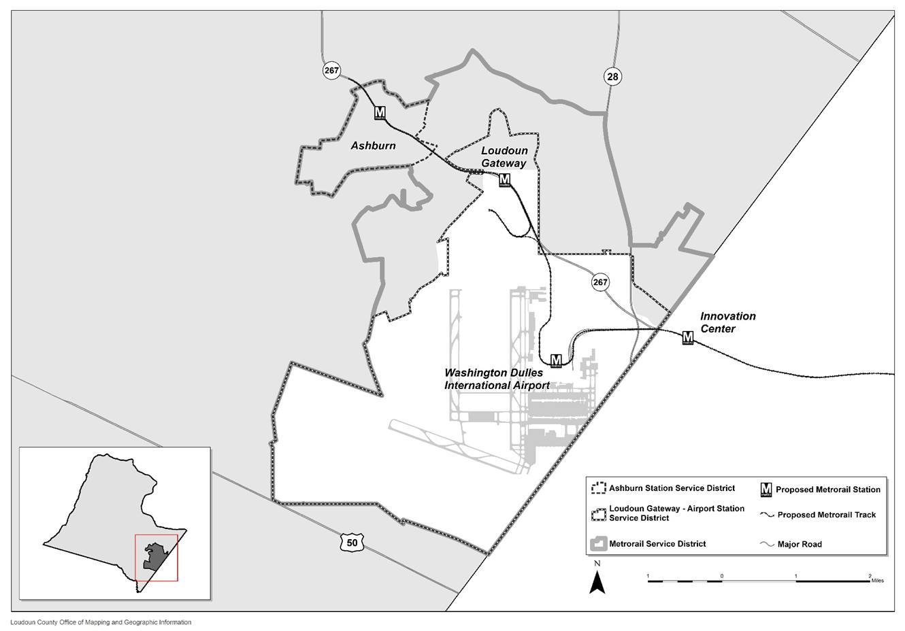
Fiscal Area Zones
Metrorail Tax District
Ashburn Station District
Loudoun Gateway – Airport Station District
Notes:
Allocation is attributed to the zones where development is expected.

Slide 8
Transportation Area Zones
Notes:
Allocation is attributed to the zones where development is expected.

Slide 9
Demographic Forecasts
Market Forecast predicts population and employment through 2040
  Development Forecast used to predict population and employment growth
Population Growth
  Used to determine the need for capital facilities
  Used as a factor to determine additional need for certain non-residential uses
Employment Growth
  Used as a factor to determine costs related to additional employees
Notes:
Population:
such as parks and libraries,
such as retail space
Employment
Helps determine trip generation and costs associated with additional employees

Slide 10
Next Steps
Working with Consultant to finalize Unconstrained Forecasts
Stakeholders’ Land Use Recommendations will be applied to the finalized forecast
Allocation of growth to the Fiscal and Transportation Zones
Feed allocated data into Fiscal and Transportation models to understand the impacts of the potential growth

Slide 11


