Slide 1
Fiscal Model Primer
Presentation to:
Envision Loudoun Stakeholders Committee
January 22, 2018
Presented by:
Julie Herlands, AICP, Vice President, TischlerBise
Beth Hilkemeyer, AICP, Department of Management and Budget

Slide 2
Overview of Presentation
Definition and purpose of fiscal impact analysis
Envision Loudoun fiscal modeling key concepts and approach
Next steps
The goal is to provide an understanding of key concepts needed to interpret and understand the fiscal impact results to be presented at a future meeting.

Slide 3
Fiscal Impact Analysis Overview
Fundamental Question: Are the revenues generated by development enough to cover related expenditures for service and facility demands?
The results are shown as “Net Fiscal Impact”
Results can be:
Fiscally positive: Revenues exceed costs
Fiscally neutral: Revenues equal costs
Fiscally negative: Costs exceed revenues

Slide 4
What Fiscal Impact Analysis is Not
Economic Impact Analysis: Measures overall economy of a community measured in income, direct/indirect jobs, consumer spending
Budget Preparation: Uses a revenue forecast to establish spending target

Slide 5
Why Do a Fiscal Impact Analysis?
Understand fiscal effects of land use policy changes
Inform the public on the connection between land use and fiscal condition
Project and compare capital facility needs
Identify revenue options
Test the impact of potential changes to services

Slide 6
Key Concepts for Envision Loudoun Fiscal Impact Analysis
Compares fiscal differences of future development
Emphasizes comparisons rather than the absolute dollar amounts
Shows magnitude and direction of differences

Slide 7
Development Assumptions: Stakeholders Land Use Recommendations

Slide 8
Development Assumptions
MARKET ANALYSIS:
DEMAND
CONSTRAINED FORECASTS: COMPARE TO SUPPLY
ANALYZE FISCAL IMPACTS:
FINANCIAL RESULTS

Slide 9
Envision Loudoun Fiscal Impact Analysis Approach
Develop Three Proposed Future Plan Scenarios
Alternative projections at three levels: High, Medium, Low
Develop a Revised General Plan Scenario: Fiscal impact of growth under the RGP (“Baseline”)
Conduct a Fiscal Impact Analysis of each Scenario
Compare fiscal impacts between RGP and potential future land use changes

Slide 10
Fiscal Impact Model and Approach Designed to Address Questions
How do the fiscal impacts of the proposed plan compare to the RGP?
How do the fiscal impacts compare among the high/medium/low scenarios of the proposed plan?
SAMPLE
(NOT LOUDOUN CO.)
Difference between scenarios is key

Slide 11
Fiscal Impact Model and Approach Designed to Address Questions
What could the fiscal impacts from plan changes be in different portions of the County?
Suburban Policy Area
Transition Policy Area
Remainder (Rural Policy Area, Towns, JLMA)
What impact on the Metrorail tax districts could the proposed plan have?
Metrorail Service District
Ashburn Station Service District
Loudoun Gateway – Airport Station Service District

Slide 12
Fiscal Model Capital Assumptions
Capital facilities include the structures used to provide government and school services
The work of Loudoun County’s Fiscal Impact Committee (FIC) will be incorporated:
2016 Capital Facility Standards generally will be used to forecast facility needs
Costs will reflect the FIC approach for the forthcoming Capital Intensity Factor (CIF), adjusted to the 2016 model base year

Slide 13
Fiscal Impact Results
Net fiscal impact results will be reported out:
By scenario
By geography
In five-year periods through 2040
In constant dollars (no inflation)
Detail available on:
Revenues
Operating expenditures
Capital expenditures and needs

Slide 14
Next Steps
Completion of development and demographic forecasts that serve as model inputs
Run fiscal model
Present results to Stakeholders Committee
Fiscal impacts of proposed land use plan
Impact of changes in Suburban and Transition Policy Areas; and remainder of the County
Tax district impacts
How results compare to future development under the Revised General Plan

Slide 15
Discussion
Questions

Slide 17
Geographies: -Suburban -Transition -Remainder
Notes:
MODELING WILL PROVIDE: FISCAL IMPACTS
Geographies: Fiscal Impacts for Suburban and Transition Policy Areas as well as Countywide
JULIE, OR BETH BACK UP: THE REMAINDER OF THE COUNTY INCLUDES THE RURAL POLICY AREA, TOWNS, AND LEESBURG JLMA

Slide 18
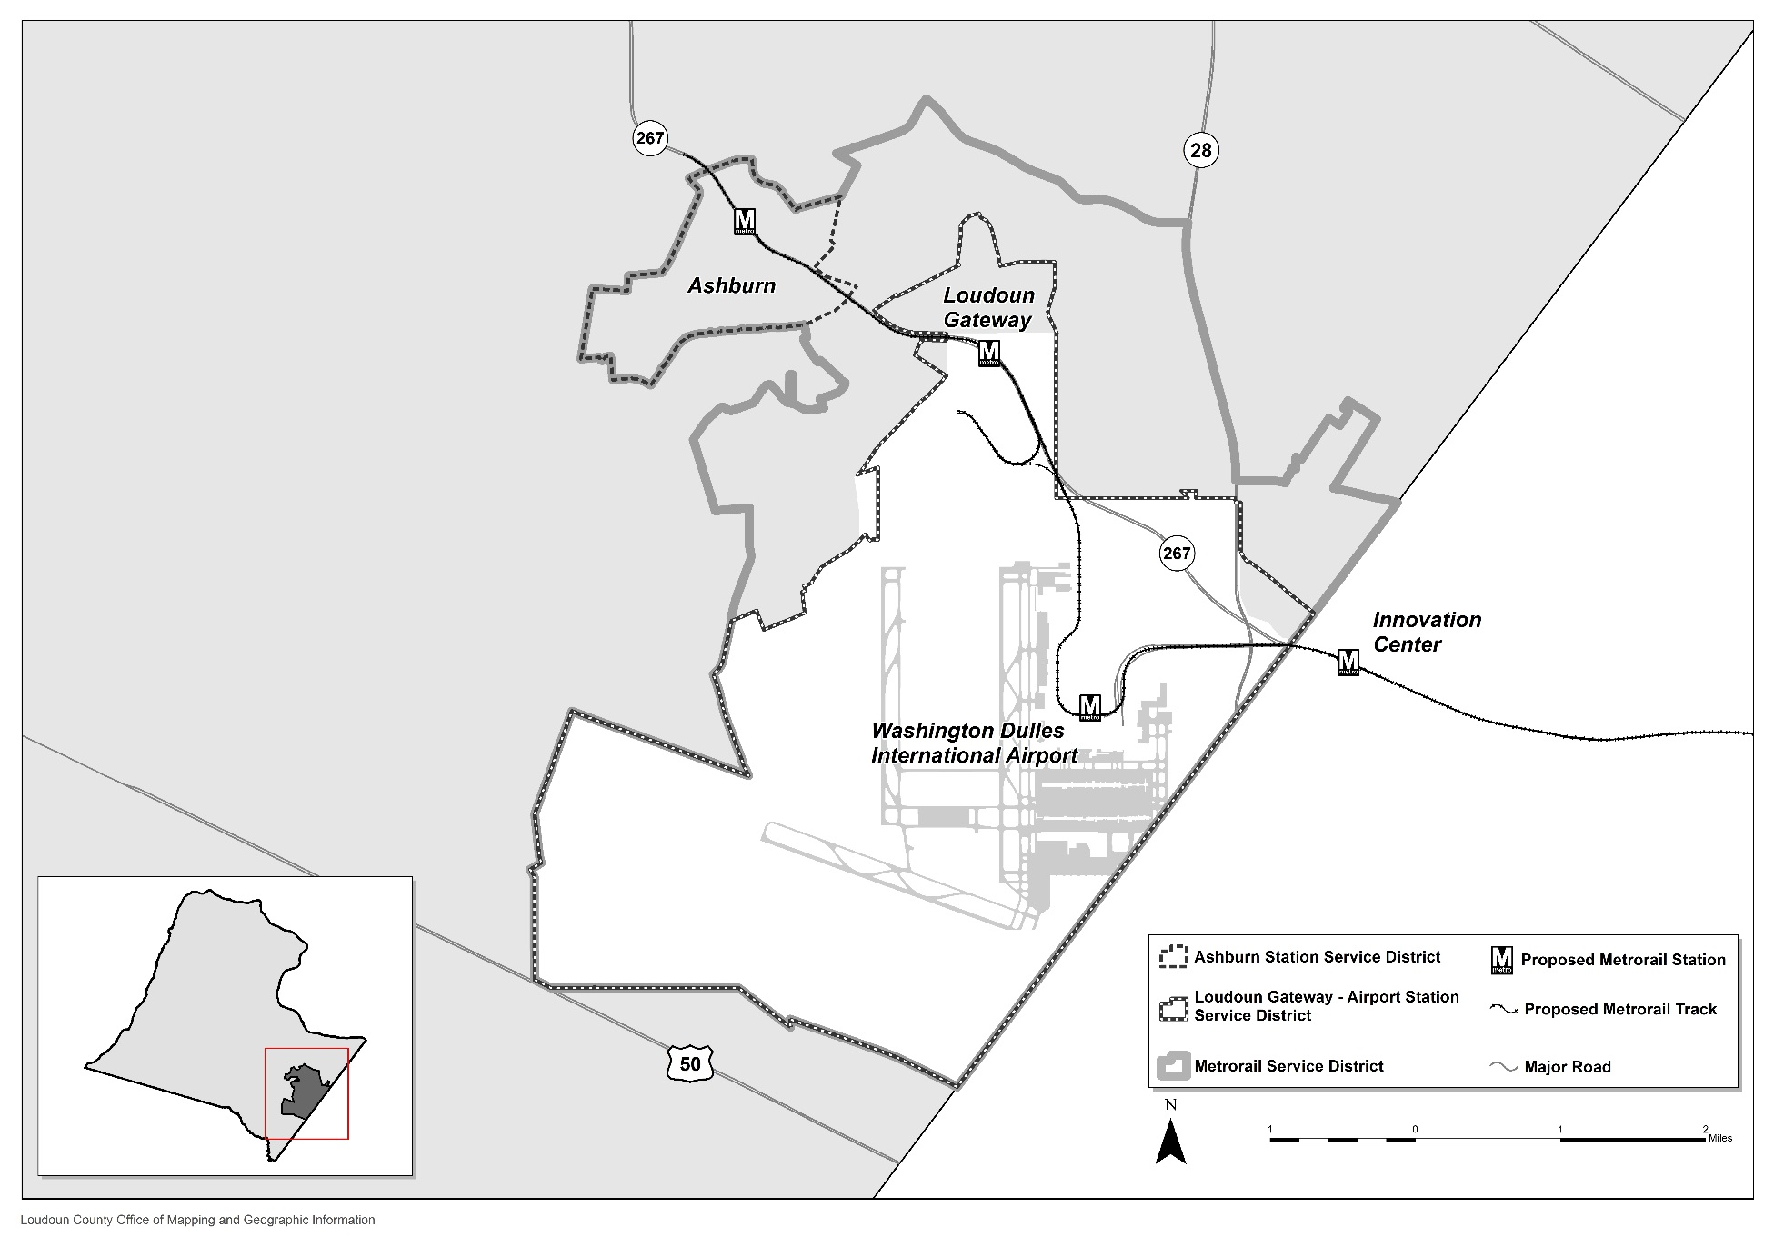
Geographies: -Metrorail Tax District -Ashburn Station District -Loudoun Gateway – Airport Station District
Notes:
ALSO IN THIS AREA
PURPOSE OF TAX DISTRICTS
CAPITAL COSTS: METRORAIL TAX DISTRICT
STATION SERVICE DISTRICTS: OPERATING COSTS
A SEPARATE QUESTION (NOT FISCAL IMPACTS) SEPARATE REPORTING OUT/QUESTION TO BE ANSWERED: NOT COMPARING TO COSTS;
MODELING WILL PROVIDE: TAX BASE (AND TAX REVENUES FOR METRORAIL SERVICE DISTRICT)
Explain:
the tax revenue (based on the current 20 cent tax rate) can be calculated for the overall Metrorail Service Tax District.
why it does not make sense to do so for the two other “station service” districts. (tax rate is zero, no point in time yet that will increase or what will increase to – although will not exceed 20 cents)

Slide 19
“What If” Questions: Sensitivity Testing
Forecasts: inputs to the model – predict the future, but only a prediction
What if development occurs faster or slower?
Show High and Low, as well as Intermediate (Medium) Forecasts

Slide 20
Capital Facility Planning
Capital Facility Standards
Capital Needs Assessment
Capital Intensity Factor
Developed every 2 years
Determine Facility scope/size
Based on population standards, or “triggers”
10 year forecast of capital facility needs beyond 6 year CIP period
Reports number and type of facilities projected to be in deficit based on future growth for each planning subarea
Measures capital cost impact as a result of adding residential density
Used to determine anticipated proffer contributions that would mitigate the impacts of residential rezonings

