Slide 2
Comprehensive Plan Stakeholders Committee Meeting
March 5, 2018

Slide 3
Agenda
Welcome / Administrative Items / Information Updates
Meeting Objectives
Board of Supervisors Update and Project Timeline
General Plan Draft Chapters Presentations and Discussion: Introduction and Rural Policy Area
Break
Continued Discussion of Draft Plan Chapters
Quality Development: Policies, Actions & Strategies Presentation and Small Groups; Report Out
Adjourn

Slide 4
Meeting Objectives
Discuss Board Direction
Discuss Project Timeline & Future Meetings
Gather Feedback:
General Plan Chapter I: Introduction;
General Plan Chapter 2, Rural Policy Area Section; and
Quality Development Policies, Strategies, and Actions.

Slide 6
Update from Board of Supervisors February 22 Meeting
March 5, 2018 | Comprehensive Plan Stakeholders Committee

Slide 7
Board Update
Amended Charter
Policy Review
Towns and JLMA
Directed Fiscal Impact Modeling to Finance Committee
Directed Travel Demand Modeling to TLUC
Endorsed Project Schedule
Notes:
Several Board members expressed appreciation to Stakeholders for many hours of work contributed to Envision Loudoun

Slide 8
Project Timeline
SC Mtg.
SC Mtg.
SC Mtg.
SC Mtg.
BOS Mtg.
Feb. 20
Mar. 19
Apr. 9
June 18
July 19
SC Mtg.
Mar. 12
SC Mtg.
SC Mtg.
SC Mtg.
July 9
Apr. 2
Apr. 30
SC Mtg.
Mar. 5
Milestone: Stakeholders Work Complete
Milestone: BOS Presentation
2018
February
March
April
May
June
July
August
September & Beyond
2019
Plan Drafting & Review
Feb. 1 – Apr. 30
Plan Revision
PC Deliberation
Public Outreach Round III
May 14 – June 1
BOS Deliberation
Notes:
Added the July 9 meeting for full fiscal and travel demand model results and any resulting issues for the Planning Commission to consider

Slide 9
Meeting Layout
March 19
New Transportation Plan Chapter Review
April 2
New General Plan Chapter Review:
April 9
Constrained Forecast Results
April 30
Final Review of Complete New General Plan
Final Review of Complete New Transportation Plan
Public Input Meetings Format Review
New Transportation Plan Chapter Review
March 12
Quality Development White Paper & Policy Review
March 5
Natural & Heritage Resources
Housing
Economic Development
New General Plan Chapter Review:
Introduction
Rural Policy Area
Built Environment/ Land Use
Fiscal Management & Facilities
Implementation
Fiscal Impact Assessment
New General Plan Chapter Review:

Slide 10
Meeting Layout
July 19
Board of Supervisors Business Meeting Presentation
August - November
Planning Commission Deliberations
December - March
Board of Supervisors Deliberations
March
Board of Supervisors Endorse Plan
VDOT Review Begins
Takeaways from Public Outreach Round III
June 18
Public Outreach Round III
Public Meetings and Online
May 14 – June 1
July 9
Fiscal and Transportation Full Model Results Presentation to Stakeholders
Final Stakeholders Recommendations
STAKEHOLDERS COMMITTEE WORK COMPLETE

Slide 12
Envision Loudoun 2040 Chapter 1: Introduction
March 5, 2018 | Comprehensive Plan Stakeholders Committee

Slide 13
Chapter 1: Introduction
Overarching Goals and Vision
Basis for the Plan
Relation to Other Documents
Using the Plan
Planning Area
Plan Development
Trends
What is New

Slide 14
Committee Chapter Discussion
Each member determines their three primary comments
Go around the table for each member to state their first comment
Around again for the second comment
Around a final time for the third comment
Members can pass on any round if they don’t have a comment
Notes:
Looking for overarching comments

Slide 15
Committee Chapter Discussion
Staff will document comments in a table and consolidate repeated comments after the meeting
Staff responses will be returned to Committee
Unresolved comments will be provided to the Planning Commission
Date | Chapter/ Section | Stakeholders Comment | Staff Response | Resolution
3/5/18 | 1
Notes:
Any written comments submitted will be fed into the sopreadsheet

Slide 17
Envision Loudoun 2040 Chapter 2: Built Environment / Land Use Rural Policy Area Section
March 5, 2018 | Comprehensive Plan Stakeholders Committee

Slide 18
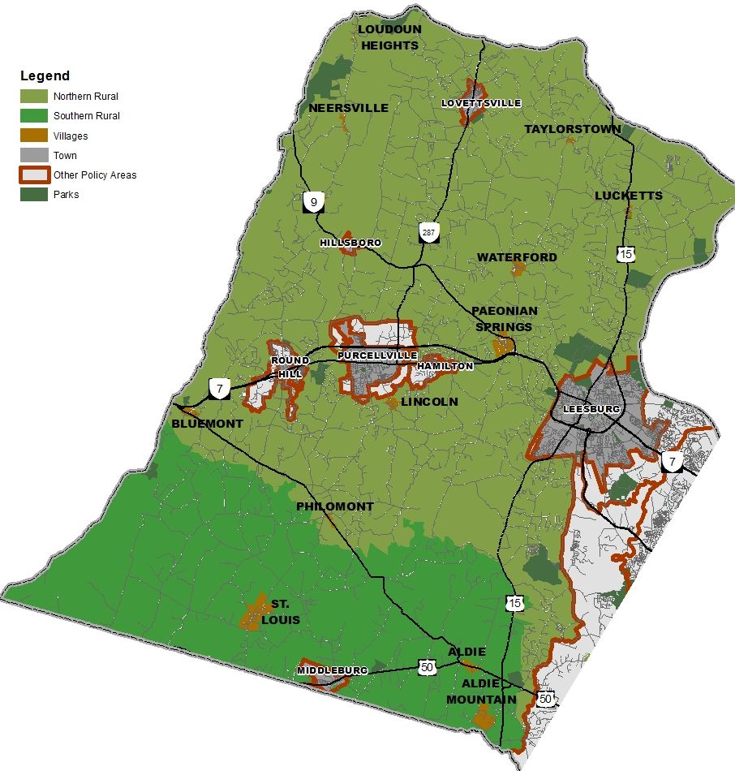
Rural Policy Area and Villages
Northern Rural and Southern Rural
230,000 Acres - 67% of land area
Twelve Existing Villages
Major Themes
Limited Residential Development
Rural Economy Uses
Maintain Character of Villages

Slide 19
Rural Policy Area and Villages
RPA Policies
Protect and preserve the rural landscape comprised of natural and man-made environments.
Limit rural residential development as a growth management strategy.
Maintain and support a vibrant agricultural base and rural economy.
Village Policy
Maintain the character and development pattern of the individual existing Villages with compatible residential and non-residential development.

Slide 20
Committee Chapter Discussion
Each member determines their three primary comments
Go around the table for each member to state their first comment
Around again for the second comment
Around a final time for the third comment
Members can pass on any round if they don’t have a comment

Slide 22
Quality Development Policies, Strategies, and Actions
March 5, 2018 | Comprehensive Plan Stakeholders Committee

Slide 23
Quality Development
Sensitive integration of the natural and environment
Pedestrian and bike friendly environments
Accessible and connected parks and open spaces
Context sensitive site and building design
Well-designed architecture
Notes:
Loudoun County has consistently focused on promoting a high quality of life for its residents by establishing standards that encourage high quality developments. For the purpose of this policy discussion, Quality Development refers to a broad area of topics related to the visual and physical qualities that new development should possess, such as sensitive integration of the natural and built environments, sustainable energy technology, pedestrian and bike friendly environments that promote activity and connectivity in spaces between buildings and developments, accessible and connected parks and open spaces, context sensitive site and building design that promotes compatibility between adjacent developments and land uses, well-designed architecture that promotes visual appeal and interest throughout the County. By encouraging quality development, distinctive identities can be realized for certain areas through the use of high quality design, siting, landscaping, architecture, signage, sustainability and other design elements. Loudoun County intends to encourage a return to historic patterns with an emphasis on conservation design, compact walkability, and public spaces that can be integrated into the evolution of existing places and in the design of new developments.

Slide 24
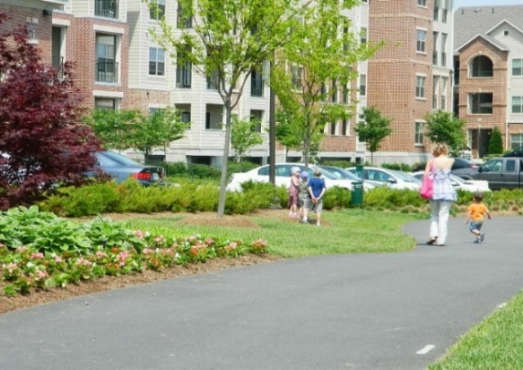
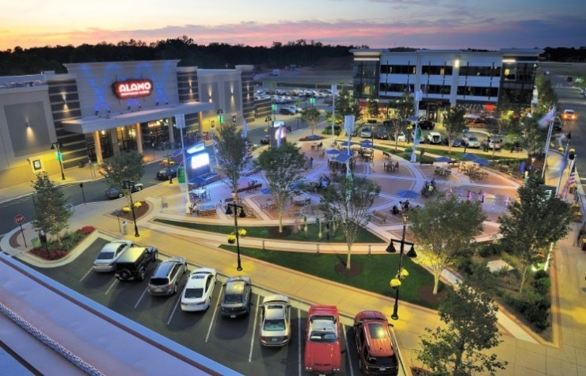
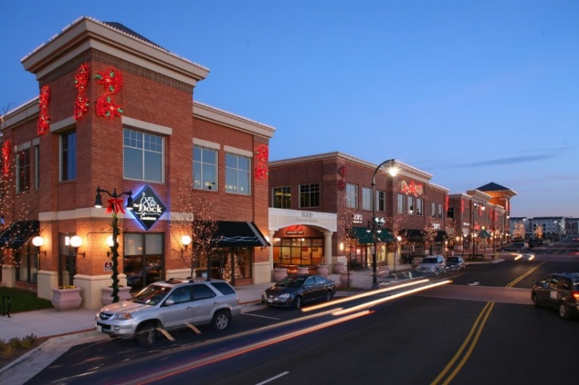
Loudoun’s Quality Development
Cascades Overlook
Lansdowne Town Center
Brambleton Town Center
Loudoun Station
Raytheon Campus
Quantum Park
Notes:
These four developments have unique features that give vibrancy and a sense of place, from a well-designed parking garage to plazas with fountains and seating areas, gateways that invite people into the space, and pedestrian focused signage and lighting.
Raytheon Campus, which utilizes dense evergreen trees to provide a visual buffer, and Quantum Park, which incorporates deep setbacks, building design, open space and ponds to provide visual appeal and interest to the site.

Slide 25
Relevant Policies, Regulations, and Programs
Revised General Plan
Adopted Zoning Ordinance
Proffers
Retail Plan Policies
Energy and Sustainability Programs
Notes:
Lay out the progress and the challenges with these
Possible Steps forward
Endeavor to unify design guidance within the new Plan that is synchronized with street and roadway design in the new Countywide Transportation Plan.
Enhance nonresidential design guidelines for all major areas in the County (based on the land use types, Policy Areas (Rural, Transition, Suburban and Urban), and more specific ones in targeted areas in the County.
Establish or enhance a sense of place from development to development and create vibrant spaces and buildings for human activity, but should not be cumbersome or overly prescriptive so as to inhibit development.
Promote programs that encourage sustainability, environmental stewardship, and protection of the environment.

Slide 26
Policies, Strategies, and Actions
Policies, strategies, and actions provide the foundation of quality development throughout the County.
Policies: 9
Strategies: 17
Actions: 17
Design Guidelines
Notes:
Recommended policies for the new plan include design guidelines as well ways to maintain and build upon the quality of life in the County. These are overarching policies for the County. The main goal of the policies and design guidelines below are to give a framework for the County as a whole on what can be achieved in regards to quality of life and provide a streamlined approach that encompasses more than just buildings, but also how the community will interact and live, work, and play in the County. **These are all carryover policies (from the 70 pages of design guidelines in various chapters of the Revised General Plan, specifically chapter 11 and then Retail plan, route 28 and 50) that have been condensed and put together in one place.
Analyze the impact a potential development may have on the urbanizing landscape, considering not only appearance, but practical considerations such as proximity and quality of connections to utilities and means of daily life or end-users. Development should respond to the local context and build and improve upon regional character.
**These are the same headers you can find in the current Revised General Plan (Retail Plan) but can be used across the county with some updated text and always using them within the context of the policy area (Urban, Suburban, Transition, and Rural).

Slide 27
Small Group Discussion
What should be modified?
What should be removed?
What has been missed?
Staff will use any feedback to further develop the Policies, Strategies, and Actions for integration into the Plan chapters.

