Slide 1
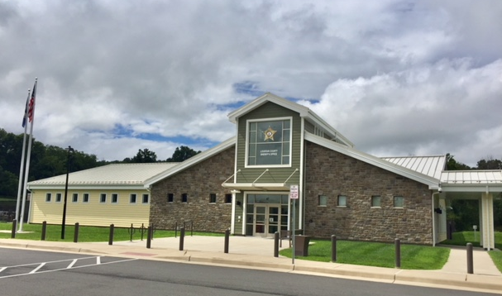

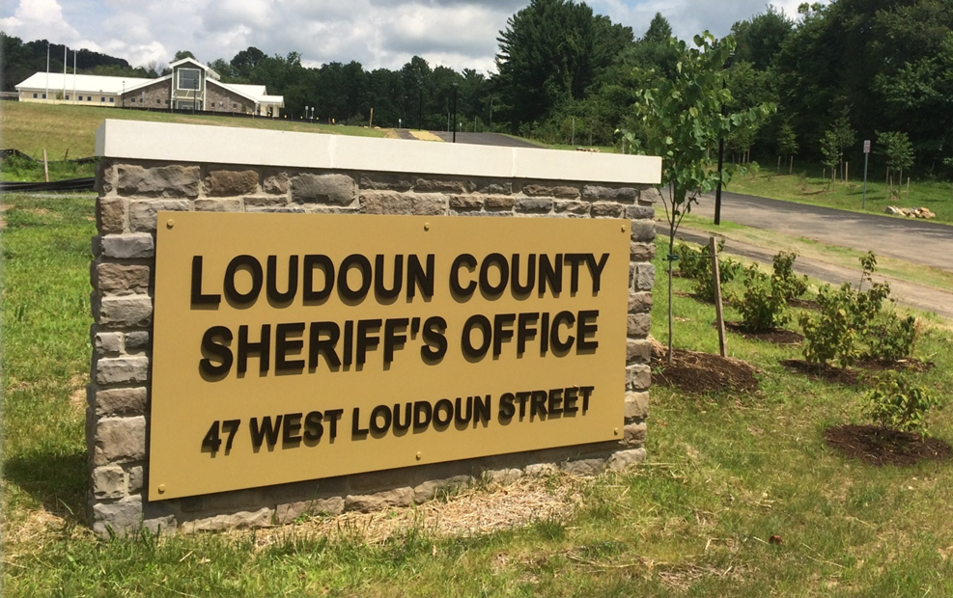
LCSO - WLS QUARTERLY
COMMUNITY MEETING
Wednesday
February 6, 2019
7:00 – 8:00 pm
Western Loudoun Station
47 W. Loudoun St.
Round Hill, VA 20141
Main # 571-258-3750

Slide 2

LCSO Mission Statement

Slide 3
WLS Organizational Chart
STATION COMMANDER
Captain Greg Ahlemann
ADMINISTRATIVE ASSISTANT
Kelly Mabe
CRIME ANALYST
Jacqueline Gallman
WESTERN
LOUDOUN
STATION
PERSONNEL
PROPERTY CRIMES &
COMMUNITY RESOURCE SERGEANT
Sgt. Joshua Brumbaugh
STATION DETECTIVE
Det. Terry Sheffer
COMMUNITY RESOURCE OFFICER
DFC Ben Fornwalt
Notes:
October 22, 2016 grand opening
Finger prints – 15
Gun Locks -3
Conceal carry permits – 3
Alarm registration request – 2
Craig's list safe drop spot request – 1
Medicine box – 2

Slide 4
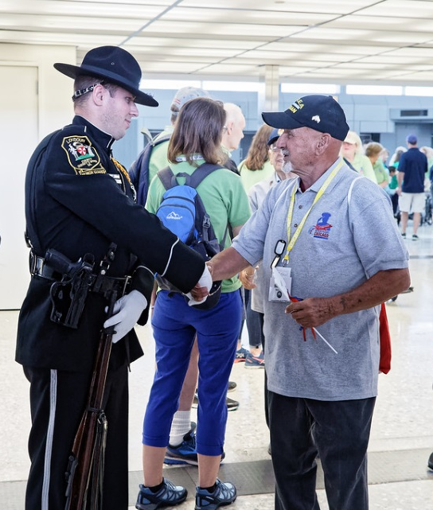
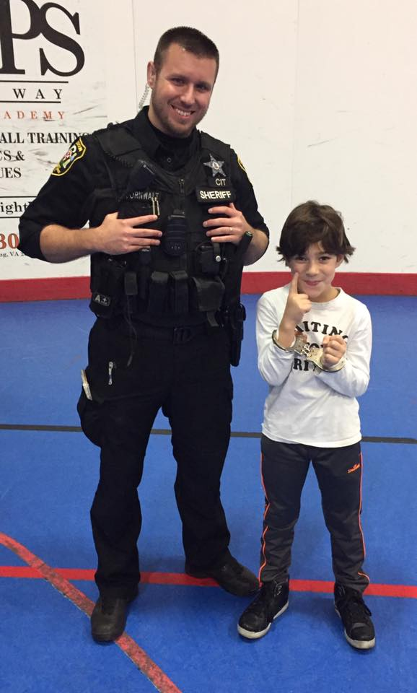
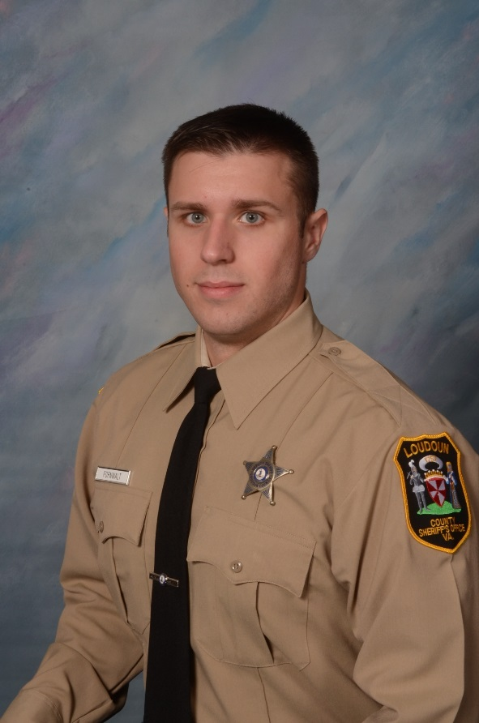
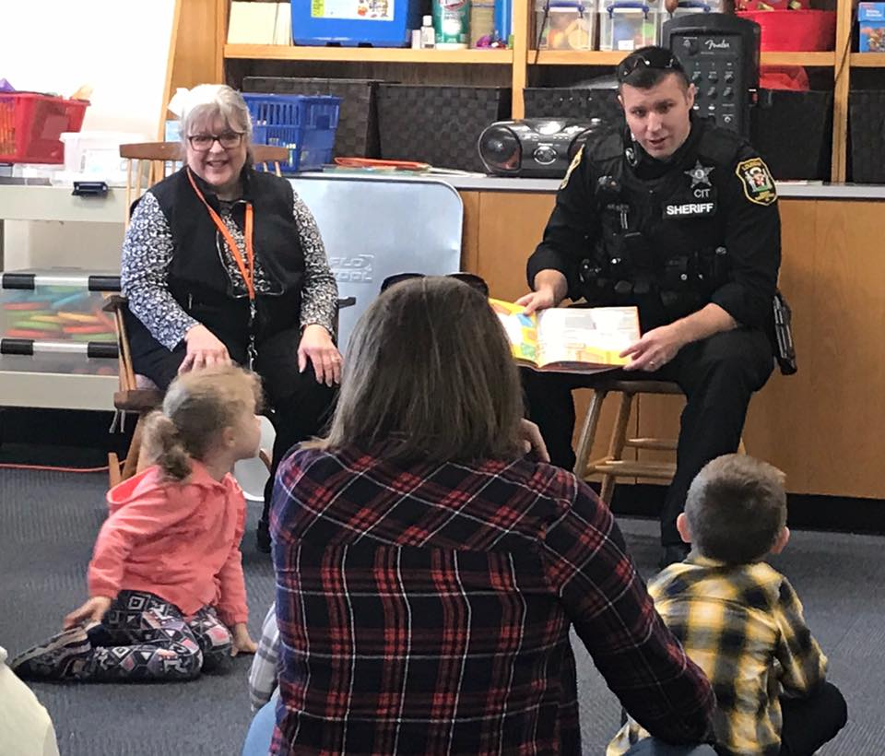
Community Resource Officer
Introducing WLS’ new Community Resource Officer!
Ben is a member of the LCSO Honor Guard.
BOOKS and BADGES
BEN FORNWALT
Community Resource Officer
571-528-3636
Ben.Fornwalt@loudoun.gov
Tuesday - Friday 10:30 AM – 9:00 PM

Slide 5
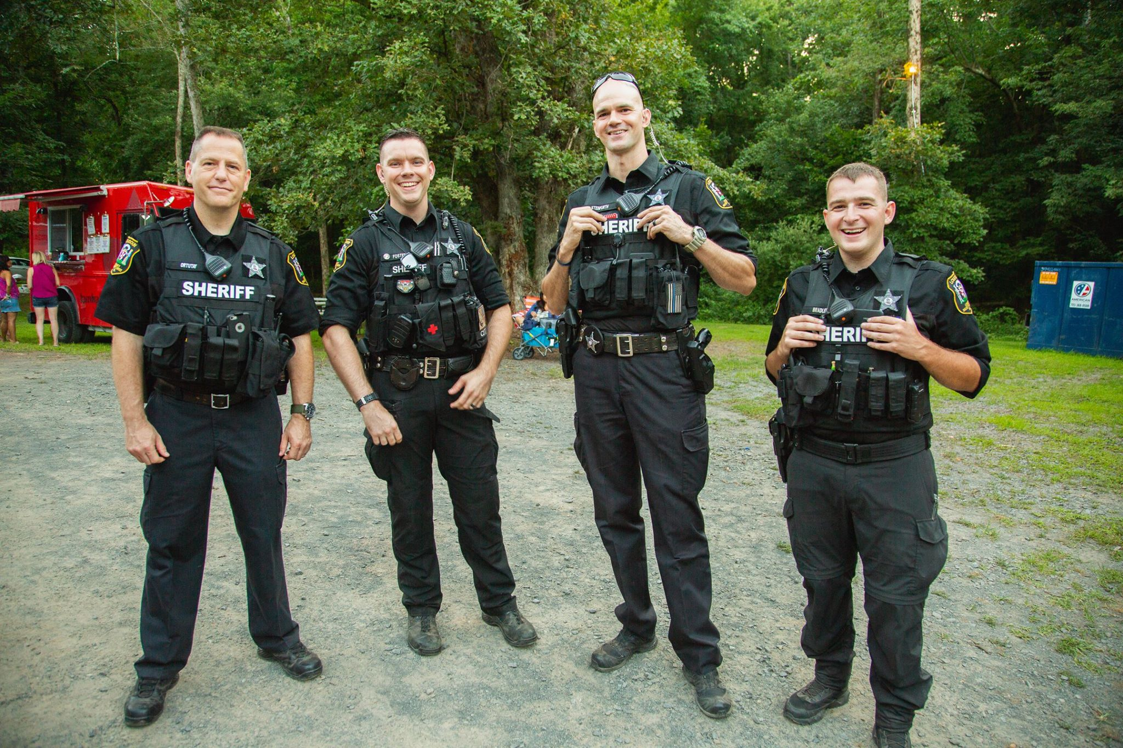
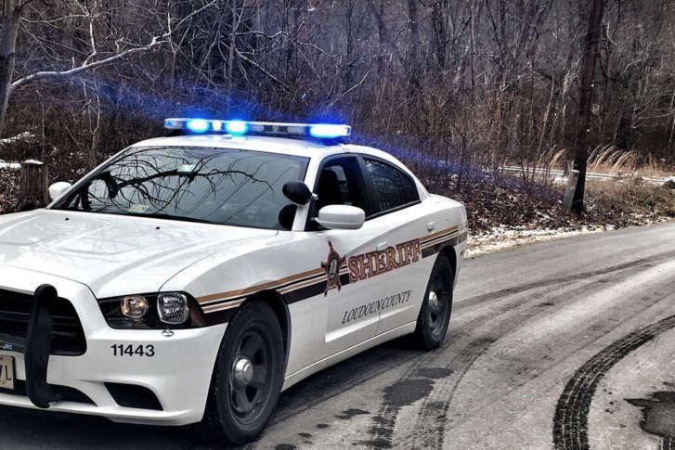
PATROL SQUADS
A Days / A Nights
B Days / B Nights
Day Shift: 6:00 am - 6:00 pm
Night Shift: 4:30 pm - 4:30 am
7:00 pm - 7:00 am

Slide 6
WESTERN LOUDOUN STATION
Service Areas
Includes service to the Town of Purcellville [700]
Western Loudoun population estimate as of January 1, 2019: 53,144
Deputy Patrol Area: Approx. 315 sq. miles
2017 Calls for Service: 20,511
2018 Calls for Service: 22,233
Western Loudoun Sectors/Beats: 510, 520, 530, 540, 550, & 700

Slide 7
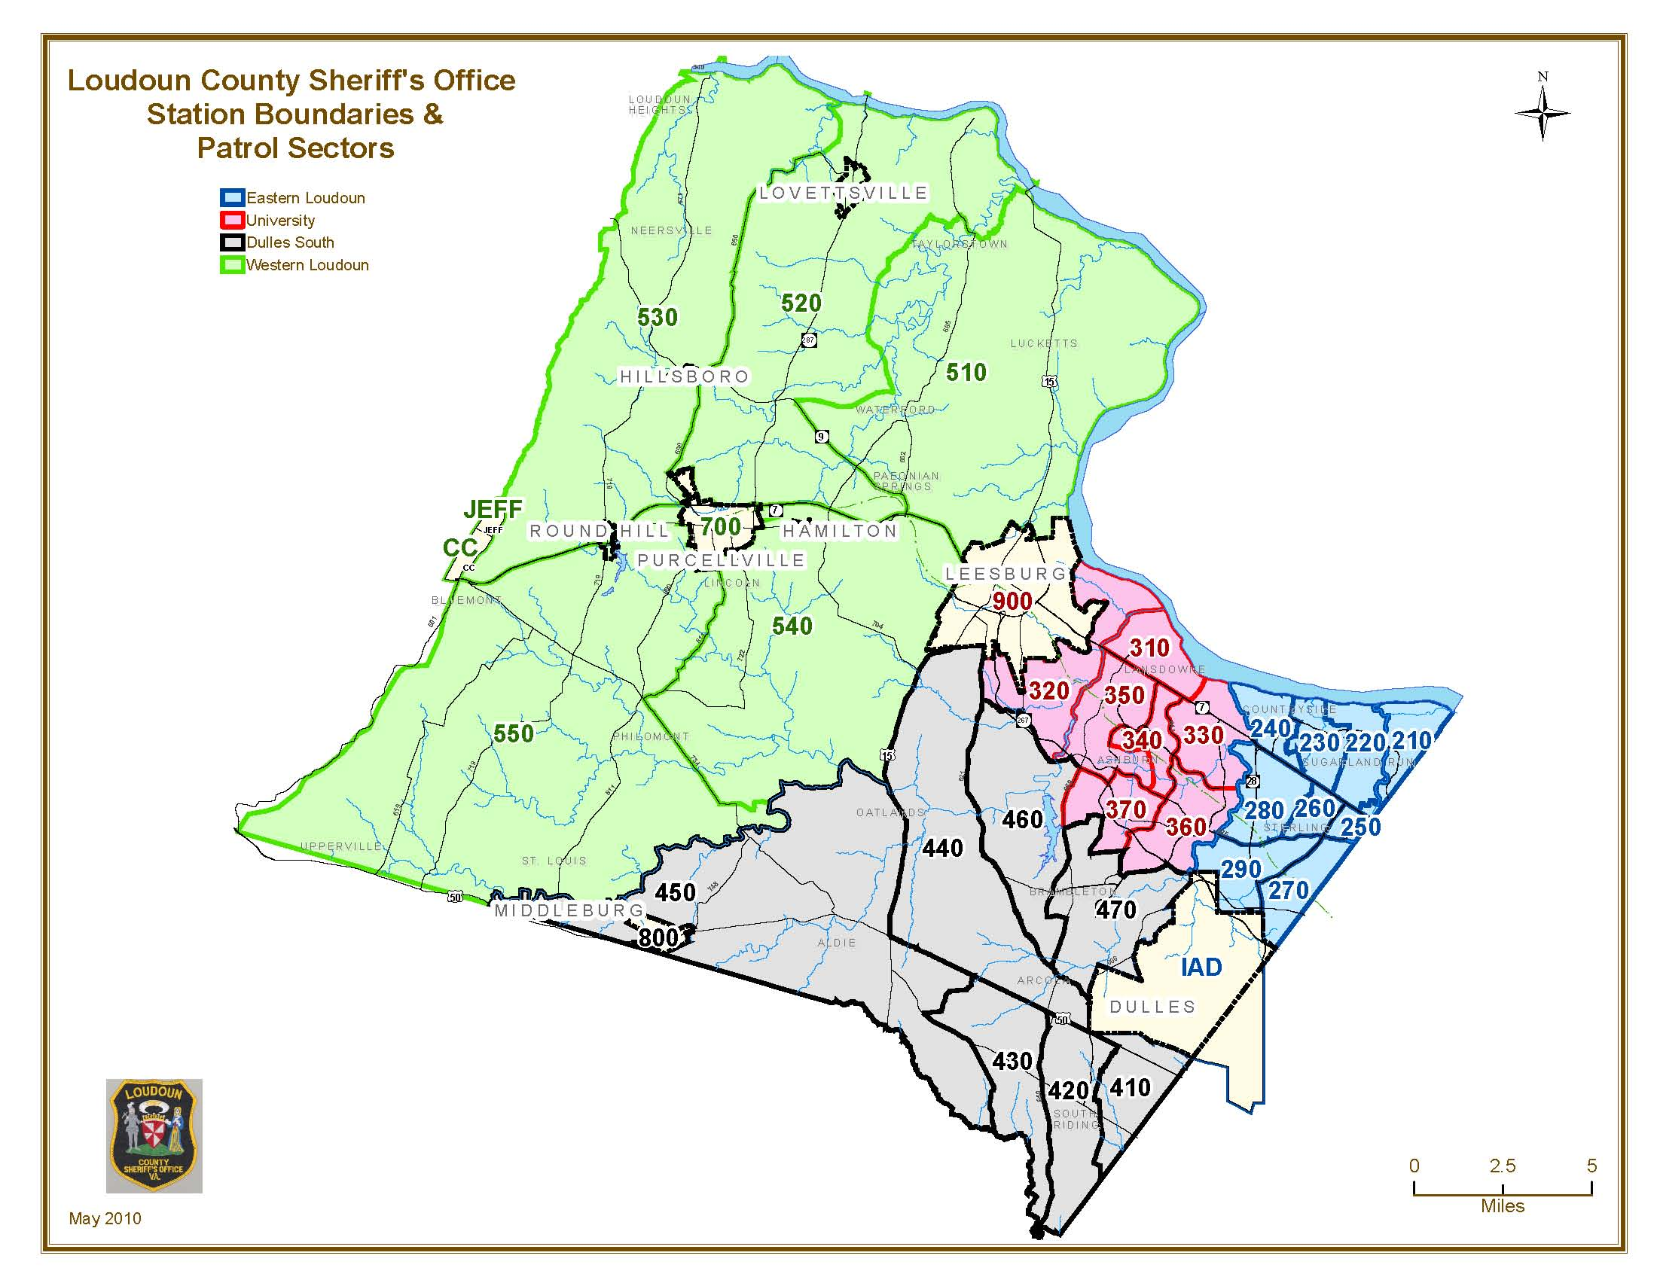
Loudoun County Map w/ Station Boundaries / Sectors
ASHBURN STATION
(300s)
Population Estimate:
94,209
35.5 sq.mi.
WESTERN LOUDOUN STATION
(500s & 700)
Population Estimate: 52,430
315.4 sq.mi.
EASTERN LOUDOUN STATION (200s)
Population Estimate: 81,899
26.8 sq. mi.
DULLES SOUTH STATION (400s)
Population Estimate: 109,856
116 sq.mi.
PATROL SECTORS ARE DESIGNED TO DELIVER EFFICIENT PUBLIC SAFETY SERVICE.

Slide 8
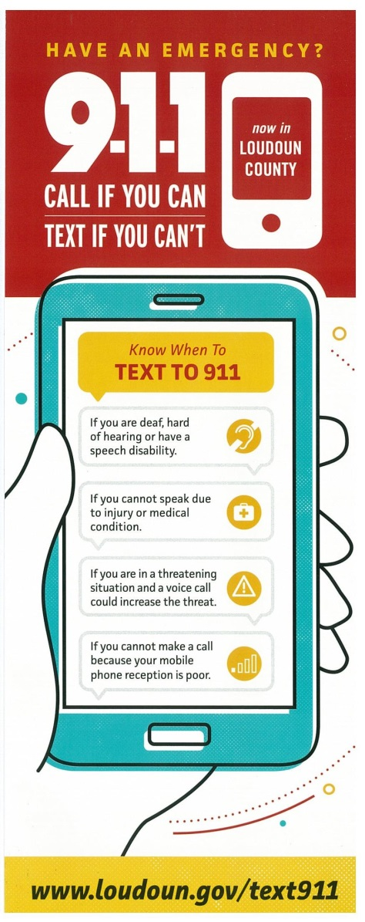
TEXT 911
CALL if You Can
TEXT if You Can’t
HOW TO TEXT TO 911:
Enter only 911 in the “To” field.
Text should be short and include:
  Location
  Type of Emergency
Be prepared to answer questions and follow Call Taker’s instructions.
Photos and videos cannot be sent to 911.
If you are deaf, hard of hearing, or have a speech disability.
Texts to 911 cannot include more than 1 recipient.
TEXT 911 is available for:
If you cannot speak due to injury or medical condition.
If you are in a threatening situation.
If your mobile reception signal is poor.
FIRE
MEDICAL
POLICE

Slide 9
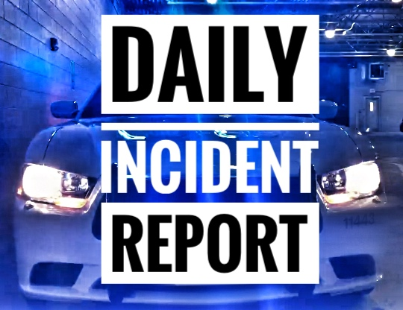
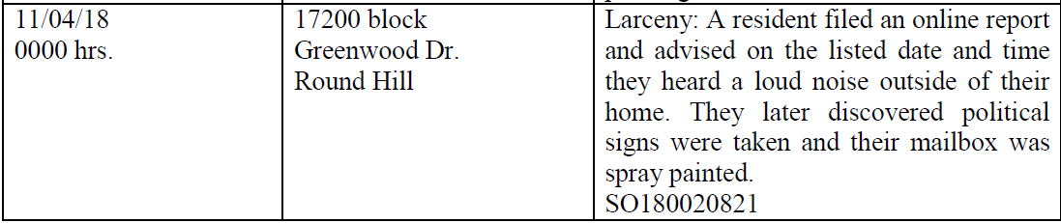
ALERT LOUDOUN
Learn About Recent Incidents and Arrests in Loudoun County via the Daily Incident Report
To receive the Daily Incident Report and other LCSO news, traffic alerts, press releases via text or email, please register for Alert Loudoun at:
sheriff.loudoun.gov/alertloudoun.

Slide 10
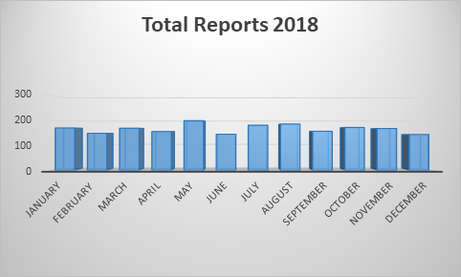
CopLogic
Online Crime Reporting Statistics
2018 COPLOGIC STATISTICS
Month | Total Reports | Hours Saved | Cost Savings
January | 169 | 338 | $12,675
February | 148 | 296 | $11,100
March | 168 | 336 | $12,600
April | 155 | 310 | $11,625
May | 198 | 396 | $14,850
June | 144 | 288 | $10,800
July | 180 | 360 | $13,500
August | 185 | 370 | $13,875
September | 156 | 312 | $11,700
October | 171 | 342 | $12,825
November | 167 | 334 | $12,525
December | 143 | 286 | $10,725
TOTAL | 1984 | 3968 | $148,800
From January 2013 – December 2018, approximately 12,738 incidents have been reported using the online reporting system CopLogic. This has resulted in nearly 25,476 deputy hours saved, at a cost savings of approximately $955,350 – approaching a MILLION TAXPAYER DOLLARS - thus far – in a period of less than six calendar years!
Notes:
January 2017
Total reports 185
Hours saved to date 370
Savings $13,875

Slide 11


CRISIS INTERVENTION
Loudoun County’s Crisis Intervention Team [CIT] Assessment Center
Shenandoah Building in Leesburg
102 Heritage Way, N.E.
Open Daily 7 a.m. to 11:00 p.m.
Contact: 911, Ask for a CIT Deputy
Designed to protect the safety, dignity, and rights of persons suffering mental health crises and to protect the community from potentially dangerous behavior.
CIT training helps law enforcement identify when someone may be experiencing a mental health crisis and adapt strategies for those individuals.
The training promotes the use of verbal de-escalation skills before using force when confronting a mental health crisis.
The training has been proven to dramatically decrease the risk of injuries or death to both officers and people with mental illnesses.
100% of all LCSO uniformed patrol deputies with two or more years on patrol are trained in CIT. Ninety-eight percent of all dispatchers and call takers in the Emergency Communications Center are also trained in CIT.

Slide 12
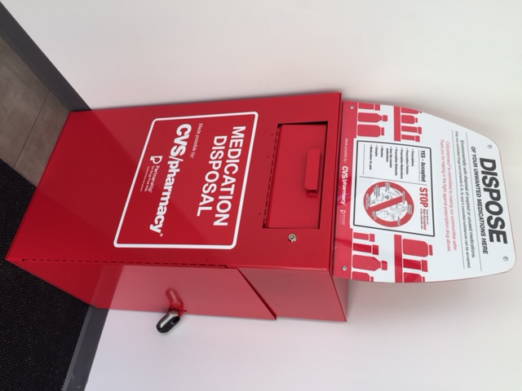
LCSO Medication Disposal Drop Box
DO YOU HAVE UNUSED OR EXPIRED MEDICATIONS?
(Available at the Western Loudoun Station, Dulles South Station, University Station & Eastern Loudoun Station)
YOU MAY DROP OFF:
  Prescription Medications
  Prescription Patches
  Over the Counter Medications
  Vitamins
  Sample Medications
  Medications for Pets
THE FOLLOWING ARE
NOT ACCEPTED:
  Needles (Sharps)
  Liquid Medications
  Aerosol Containers
  Inhalers
  Ointments and Lotions
  Medications from Businesses

Slide 13


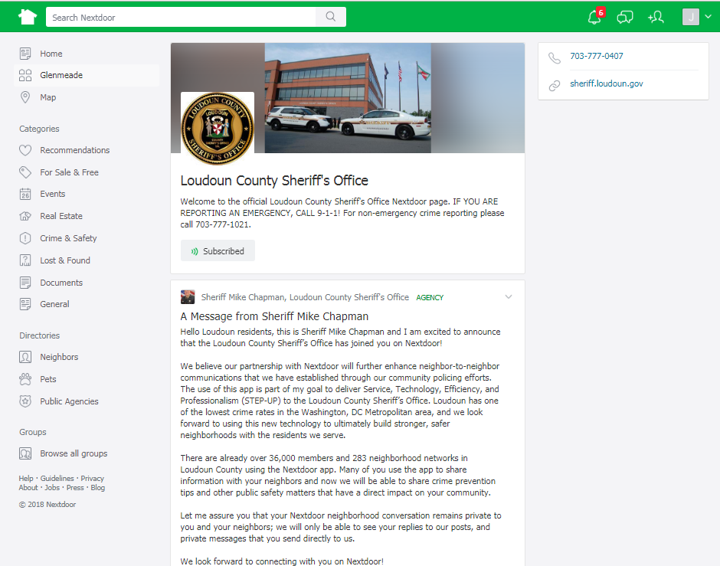

LCSO is on Nextdoor
Are You on Nextdoor?
Inform You of Public Safety Matters Directly Impacting Your Community
Get to Know your Local Deputy
Receive Resident Feedback
Stay in the ‘Loop’ about Crime & Safety Issues in Your Community

Slide 14

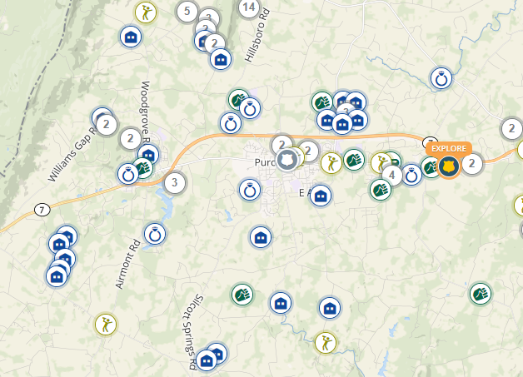
The LCSO uses CrimeReports.com
An online mapping and analysis service
Combines law enforcement data with Google-based mapping and an analytics module
Members of the public can view police data in both a high-impact map and a summary descriptive format
Crimereports.com allows for the option for
residents to register their security cameras at crimereports.com/camera_registration
Registration is 100% voluntary
Does not provide law enforcement with direct access to your security system/camera
Your personal information will be kept confidential by the LCSO
Registration information will only be accessed by law enforcement if there is a criminal incident that was possibly captured by your security camera
LCSO detectives or deputies may request a copy of any video captured by your camera if it may assist in the investigation of a crime

Slide 15

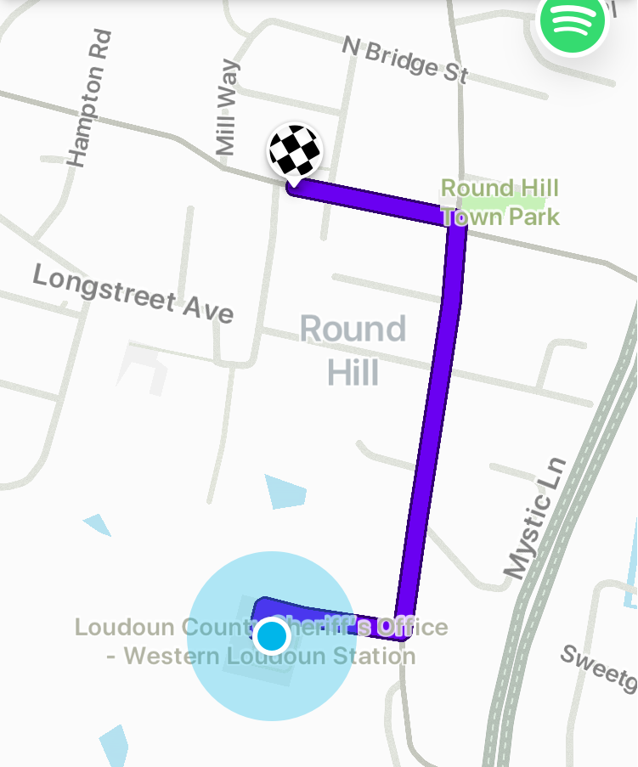
LCSO is on Waze
Earlier this year the LCSO began providing local incident data directly to Waze, the world's largest community-based traffic and navigation app.
As a result, Waze users will have an enhanced experience in Loudoun because data is sent directly to Waze from the county’s Computer-Aided Dispatch (CAD) system, LCSO calls, and calls that are dispatched by the LCSO Dispatch Center to the Virginia State Police.
Loudoun County was one of the first Virginia localities to participate in the Waze Connected Citizens Program.

Slide 16
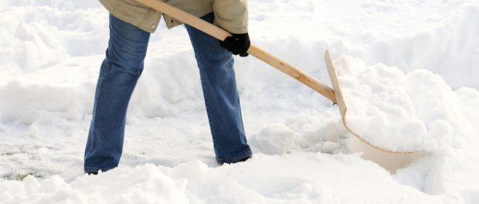
REMOVAL OF SNOW & ICE
Loudoun County Ordinance 1022.01
Every occupant, owner or other person in charge of any occupied
property in the County which has a sidewalk (or a footway of stone,
brick, gravel, cinder, wood or other substance, when such sidewalk
or footway is publicly owned or maintained, and is adjoining and
touching the property in front, rear or either side thereof):
Shall have all snow and ice, and any combination thereof, removed from such sidewalk or footway within six (6) hours after such snow or ice, or a combination thereof, has ceased falling,
Unless the same has ceased falling during the night, in which case it shall be removed before 12:00 noon following the night in which the snow or ice, or combination thereof, has fallen.
In the event snow or ice, or a combination thereof, has ceased falling upon a Sunday, such occupants, owners or other persons in charge shall have until 12:00 noon the immediately following Monday to comply with this requirement.
In the event that snow or ice, or combination thereof, causes the closure of the Loudoun County Government, the occupant, owner or other person in charge of a property shall have an additional forty-eight (48) hours to fulfill these requirements.
Enforcement. The Loudoun County Department of Planning and Zoning, Zoning Enforcement Division, and/or other such Department as may be designated by the County Administrator, shall be responsible for enforcement of this section.
Applicability Within Incorporated Towns. This section shall not apply within any incorporated town.

Slide 17
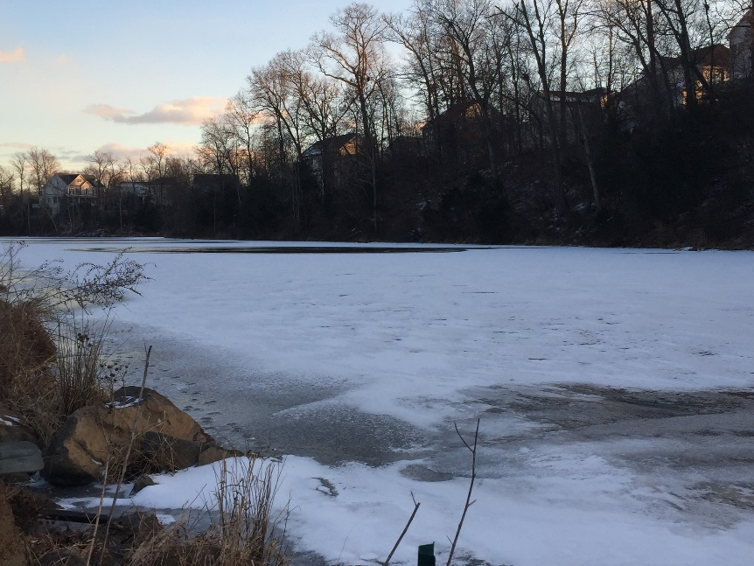
DON’T FIND YOURSELF ON THIN ICE
Never Walk or Attempt to Drive on Frozen Waterways
Many Communities Strictly Prohibit Ice Skating on Frozen Ponds
Never Attempt to Enter Water if Someone Has Fallen Through the Ice- Call 911 & Extend a Branch or Rope.
Immediately Report Anyone Attempting to Venture on the Ice & Speak With Your Children About the Danger of Walking on and Playing on Frozen Waterways

Slide 18
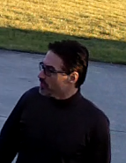
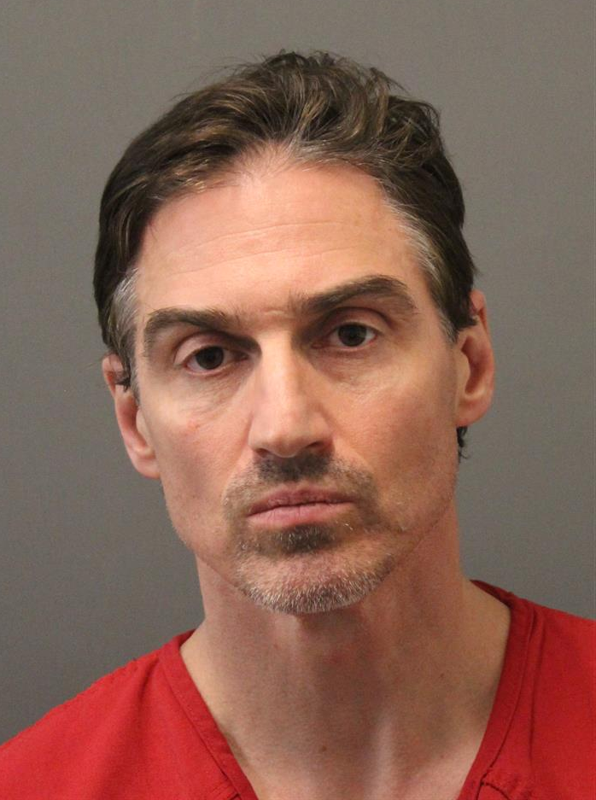
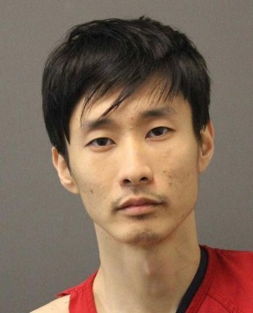
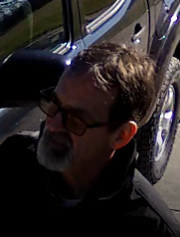
SIGNIFICANT INCIDENTS
JOSEPH QUINN
HYEONG J. SUH
ARREST: Joseph Aaron QUINN, of no fixed address, was arrested on Jan. 9 for 2 incidents of unlawful entry which occurred on Dec. 18 at two separate locations on Sierra Lane, in Lovettsville. While one of the homeowners was checking his surveillance video after returning home in the evening, Quinn was observed having been inside of his residence during that day.
Quinn has a known history of similar inappropriate and stalking behaviors around females throughout the region.
ARREST: Hyeong J. SUH, of Reston, was arrested Jan. 21 for attempted capital murder of a law enforcement officer and breaking and entering resulting from an incident which occurred Jan. 17 in Paeonian Springs, in which units responded to a trespassing complaint. SUH forced entry into a residence which contained firearms. SUH fired a weapon several times, including rounds at two responding deputies. He remains held at the Loudoun County Adult Detention Center without bond.

Slide 19
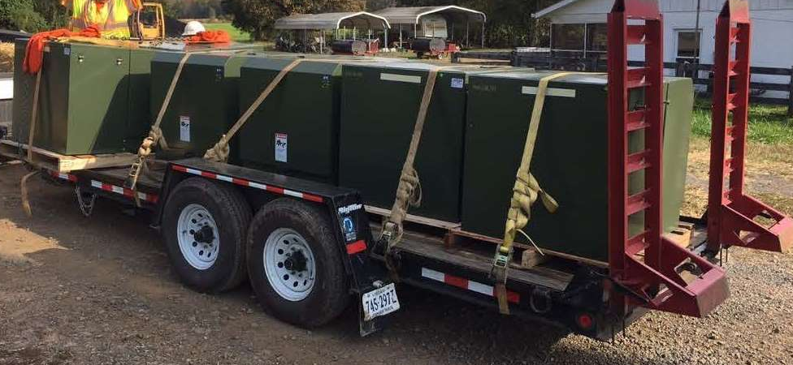
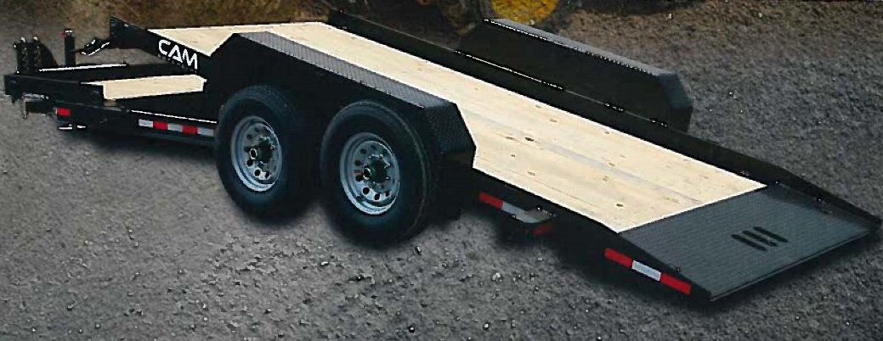
SIGNIFICANT INCIDENTS
Larceny of Construction Trailers
1
3
Actual Trailer
Stock Photo
Between Dec. 14 - 18, a 2016 black Towmaster B-6D flatbed trailer, the property of JC Roman Construction Co, was stolen from where it had been parked on Beacon Hill Drive, Leesburg, in the location where the company was laying wire.
Between Dec. 23 - 26, a black 6’x12’ 2005 Bri Mar dump trailer, bearing a company sign of COMCRUZ (green lettering on white background), was stolen from where it had been parked on Hawthorn Valley Way, in Round Hill. A locking device to the trailer had been cut off.
Between Jan. 22 - 23, a utility trailer owned by Phillips & Son Drilling, Inc., which had been parked at a construction site near Platinum Drive, Round Hill, was stolen. The trailer is described as a black 19’ Superline utility trailer with a silver aluminum tool box and a spare tire on the side.

Slide 20
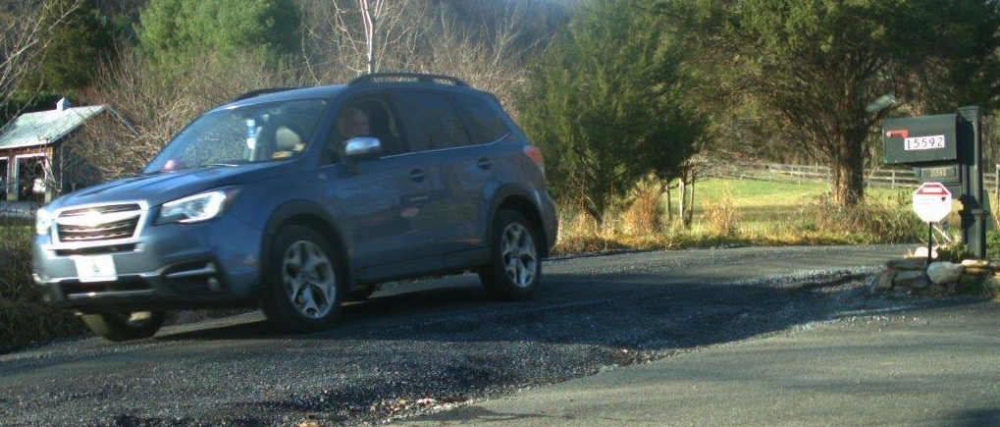
SIGNIFICANT INCIDENTS
Throw Missile at Vehicles
Trash Dumping
On Sunday, Dec. 9, 2018, between 10:00 - 10:30 p.m., five separate complainants reported incidents of large rocks being thrown at their vehicles by a vehicle passing in the opposite direction on Charles Town Pike and Hamilton Station Road, in the areas of Paeonian Springs and Hamilton. One driver was hit by the rock after it broke through his driver’s side window, but did not suffer serious injuries. One of the vehicles was a Loudoun County F & R vehicle, which suffered damage to its emergency equipment. All vehicles suffered broken windows or other types of damage.
ARREST. Robert REED, of Martinsburg, WV, was arrested for multiple misdemeanor charges of trash dumping stemming from approximately 30 incidents between September 3 and December 6, 2018. REED confessed to throwing his discarded beer bottles onto driveways along Ashbury Church Road.
Tailgate Larcenies
On January 2, tailgates were removed during the daytime hours from two 2012 F-250 Ford pickup trucks which had been parked at the Harmony Commuter lot on E Colonial Highway, Hamilton.

Slide 21
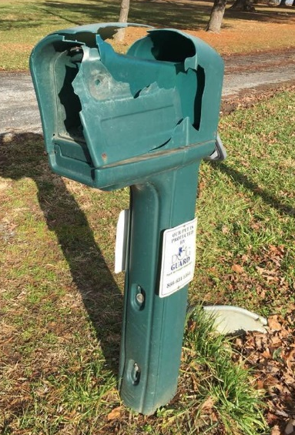
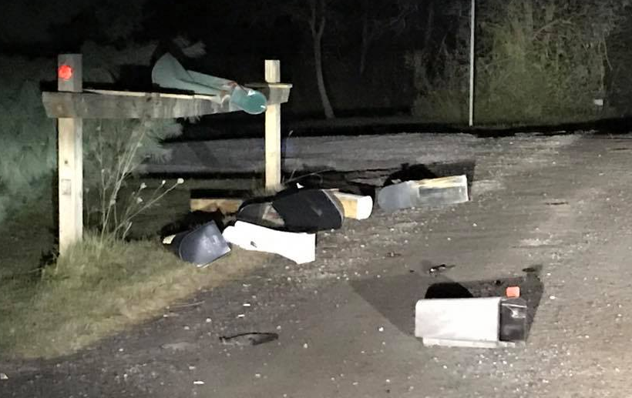
SIGNIFICANT INCIDENTS
VANDALISM – Destruction of Mailboxes
December 1: A resident on Yellow Schoolhouse Road reported their mailbox had been smashed in the early morning hours.
December 7 - 8: One resident on Canby Road reported their mailbox had been destroyed overnight. During the same time frame, three sign posts at the corner of Ketoctin Church Rd & Osburn Road appeared to have been knocked down by a vehicle driving over them.
December 15 – 16: Twenty-two Hamilton residents reported the destruction of their mailboxes which had occurred during the overnight hours. Mail and packages had also been removed from the mailboxes. In some instances, the contents were discarded along the roadway, and in others, contents were stolen.
December 21 – 22: Multiple residents of the Hamilton and Purcellville areas reported their mailboxes had been damaged during the overnight hours. Many more were reported on social media which were not reported to LCSO.
December 22 – 23: Multiple residents of Waterford reported their mailboxes had been damaged during the overnight hours.
December 24 – 25: Multiple residents of Bluemont, Purcellville, and Round Hill reported their mailboxes, driveway lamps, and a custom business sign had been destroyed during the overnight hours. Many more were observed in other areas by LCSO personnel, which had not been reported.
*** This is in addition to 30+ mailbox incidents reported in October, and 12 in November (involving mailboxes and driveway lamps).

Slide 22
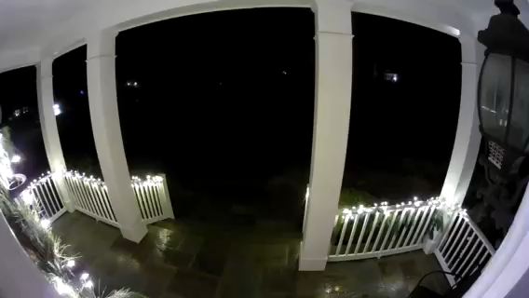
SIGNIFICANT INCIDENTS
VANDALISM – Destruction of Mailboxes
Ring doorbell video: Hamilton – December 16, 2018 – 2:17 a.m.

Slide 23

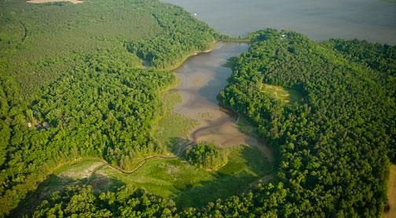
GUEST SPEAKERS
MARK DILUIGI
and
RAY SOLOMON
Master Conservation Police Officers
VA Department of Game and Inland Fisheries
Law Enforcement Division Region IV
540-899-4169 office

Slide 24
REMINDERS
LOCK personal vehicles! Did you know that more vehicles are entered through unlocked doors than by force?
Secure valuables in a locked vehicle trunk (i.e. not in plain view)
Close AND LOCK residential garages, doors, and outbuildings
SAFELY SECURE all firearms!
LCSO NON-EMERGENCY NUMBER:
(703) 777-1021

Slide 25
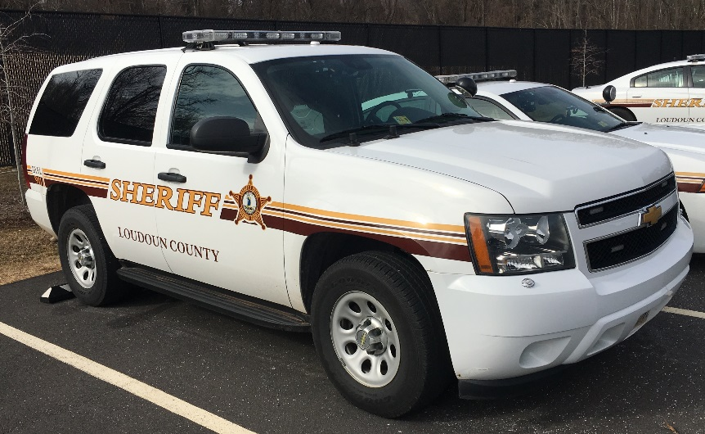
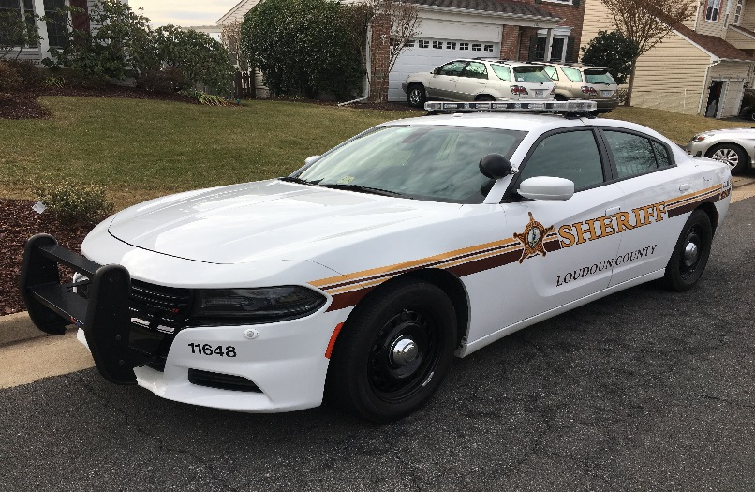
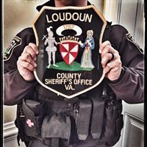
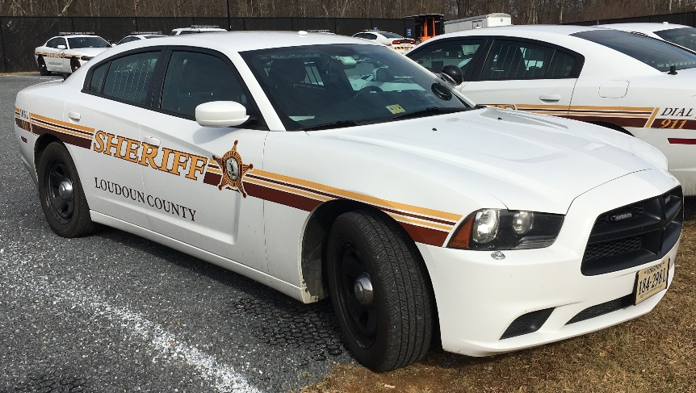
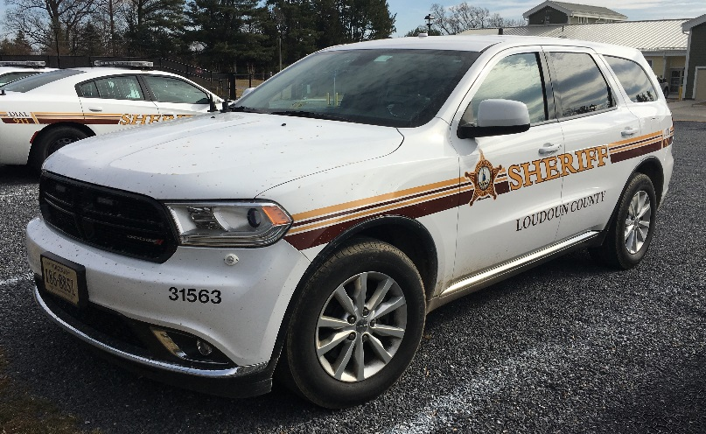

QUESTIONS, COMMENTS, CONCERNS…
CONCLUSION

