Slide 1
LOUDOUN COUNTY
JOB ORDER CONTRACTING SERVICES
ROOF REPAIR AND REPLACEMENT
IFB NUMBER: RFQ 189783
MARCH 2020

Slide 2
Pre-Proposal Meeting Agenda
JOC Overview
The Contract Documents
Contract Specifics
Understanding the Construction Task Catalog® (CTC)
Calculating the Adjustment Factors
Completing the Bid Form
Considerations
Review of Key Points
Bid Submission

Slide 3
County JOC Overview
Using Job Order Contracting since 2006
Typically Uses JOC for:
Facility Repair and Renovation Projects
Straightforward Work Items
Replacements in Kind
County Has Trained and Dedicated Staff to Manage JOC
Statistics:
Approximately $118 Million in Work Ordered
5,500 individual Job Orders
Average Job Order size is $50,000
Includes Supplemental Job Orders

Slide 4
JOC Overview
Definition
Indefinite delivery/indefinite quantity process (IDIQ)
Enable contractors to complete a substantial number of individual projects with a single bid
Tasks based on competitively-bid, preset prices
Saves time and money
Provides transparency and auditability
Value

Slide 5
JOC Overview: Umbrella Contract

Slide 6
JOC Overview: Why JOC Works For Contractors
Quality work is rewarded with more work
Profit is a function of volume
Volume is driven by performance
JOC provides a steady flow of work
Win a higher percentage of proposed projects
Easier process for project proposals
Long-term relationship with the County
Good work is rewarded with more work
Develop partnership with the County
Ability to leverage Subcontractor and Supplier relationships
Ability to sell value, not just compete to be the lowest price

Slide 7
JOC Overview: Why JOC Works For Contractors
Reduced Risk
Fixed prices
No negotiations
Payment for every element of work performed
Ability to provide input during scope development
Eliminates quibbling over change orders
Reduced chance of claims
Build bond capacity
Larger presence and enhanced reputation in the local community

Slide 8
JOC Overview: Why JOC Works For Facility Owners
A Fixed Priced, Fast Track Procurement Process
Job Orders are Lump Sum
The Ability to Accomplish a Substantial Number of Individual Projects with a Single Competitively Bid Contract
Contractor Has A Continuing Financial Incentive To Provide
Responsive Services
Accurate Proposals
Quality Work on Time
Timely Close Out
Future Purchase Orders Tied to Contractor Performance
No Obligation To Award Specific Projects
the County can Use All Other Methods For Accomplishing Projects

Slide 9
JOC Overview: Why JOC Works For Facility Owners
Increases use of local subcontracting businesses
The absence of pre-established quantities inhibits trade staffing by the prime contractor.
Responsiveness requires the prime to use multiple local subcontractors.
No bonding requirement for the sub, faster payment, and less red tape, thereby expanding business opportunities for small businesses
The County reviews and approves all Subcontractors prior to issuing Job Orders
Increases Transparency
The County Has the Ability to See and Review the Back-Up Pricing Details
Schedule Flexibility
No Shelf Life for Prices or Job Orders
Fast procurement cycle is good for end of fiscal year projects

Slide 10
JOC Overview: The JOC Process
Joint Scope Meeting With the client, Contractor, and Others to define the Detailed Scope of Work
County Issues Request for Job Order Proposal for the Agreed Upon Detailed Scope of Work
Proposal Development
Typical Proposal Due Date will be 2 weeks from Request for Job Order Proposal
Proposal Review
Issuance of Job Order
Total Time Goal: Average 3-5 weeks

Slide 11
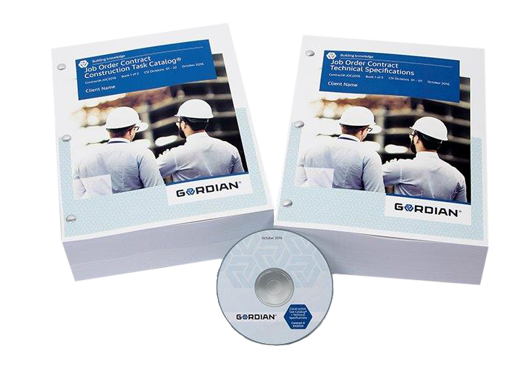
The Contract Documents
Invitation for Bid
The Construction Task Catalog®
The Technical Specifications

Slide 12
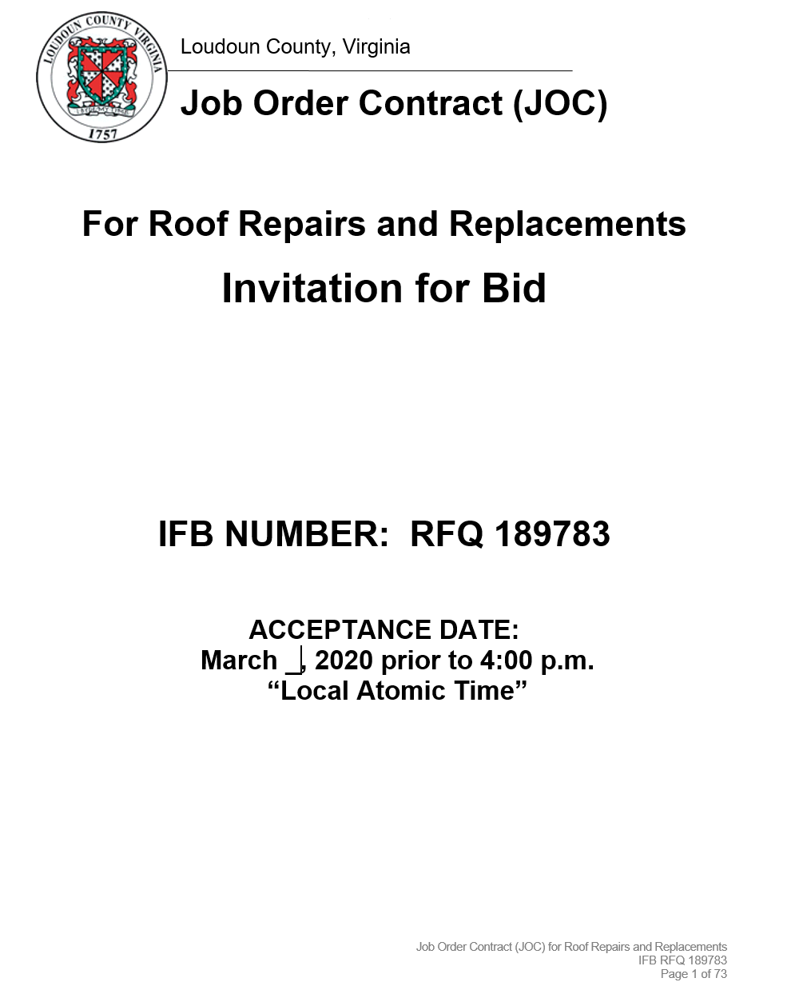
The Contract Documents
Invitation for Bid
Purpose
Overview of the Contract
Minimum Qualifications
Terms and Conditions
Instructions to Bidders
JOC Procedure for Ordering
Agreement
Forms to be Submitted with the Bid

Slide 13
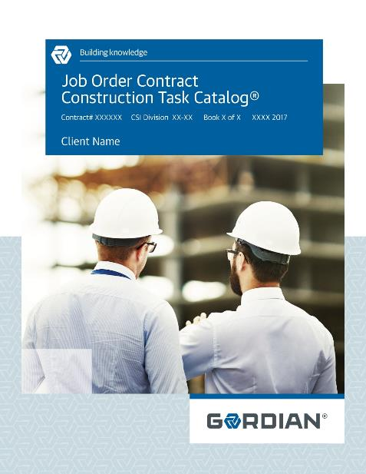
The Contract Documents
The Construction Task Catalog®
Catalog of Pre-Priced Construction Tasks
Organized by Construction Specifications Institute (CSI)
Based on Local Labor, Material & Equipment Costs
The tasks represent the “Scope of Work” for the contract

Slide 14
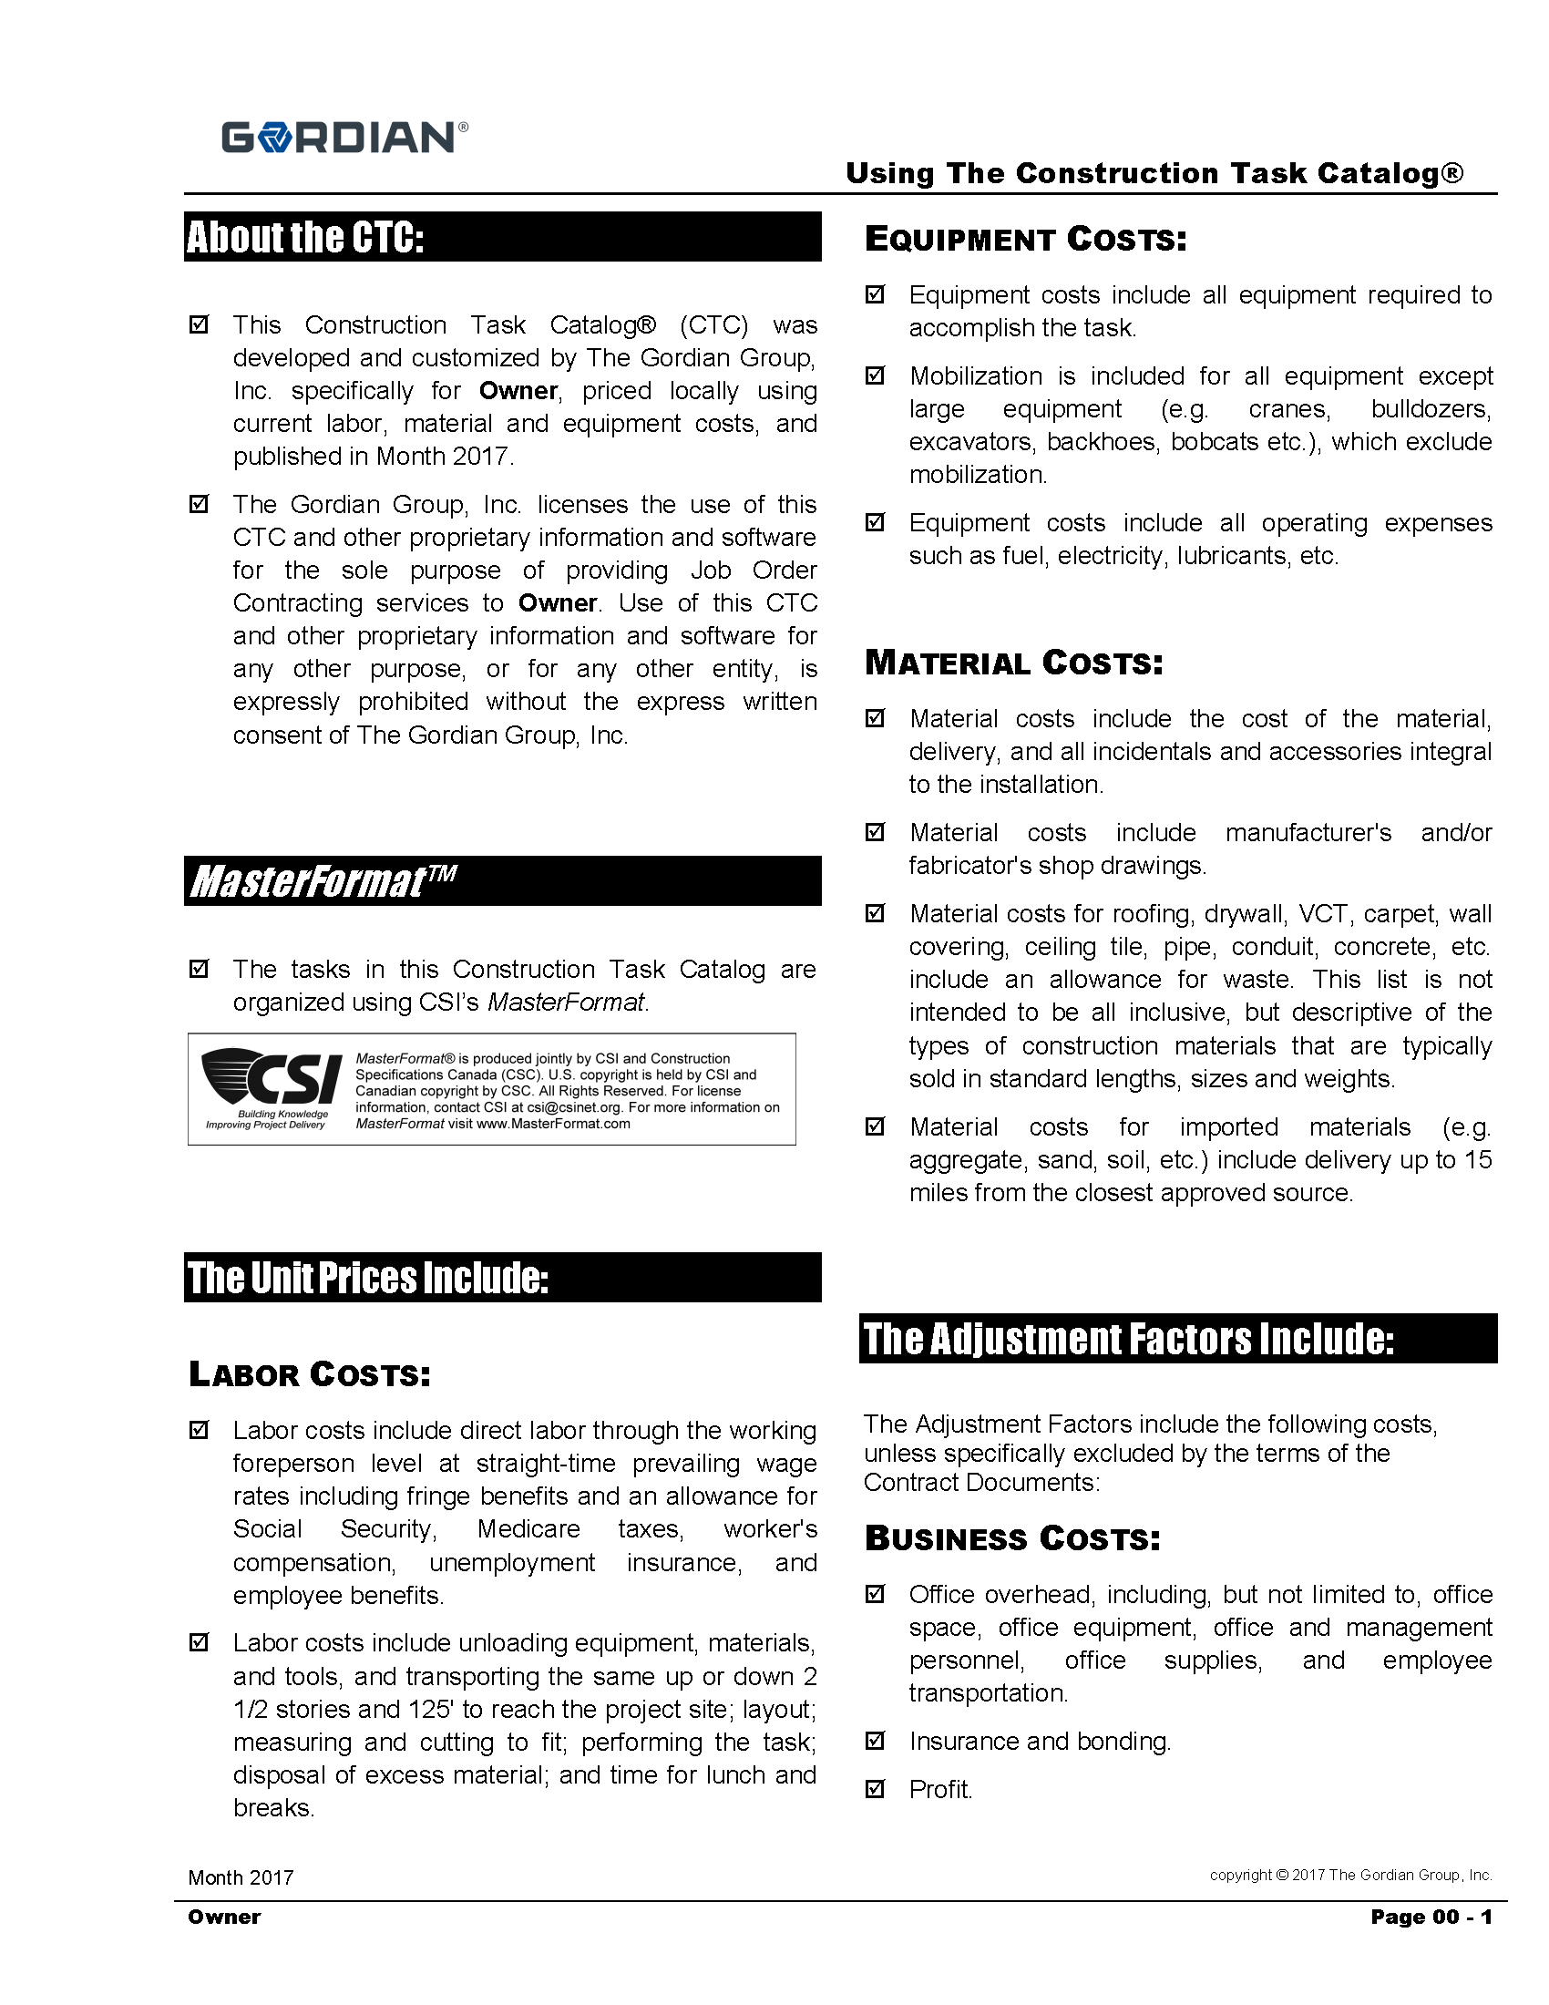
The Contract Documents
The Construction Task Catalog®
Contractor must review and understand “Using the Construction Task Catalog®”
Rules of the game
Make sure you get paid for all appropriate tasks
Pages 00 – 1 to 00-6 of the CTC

Slide 15
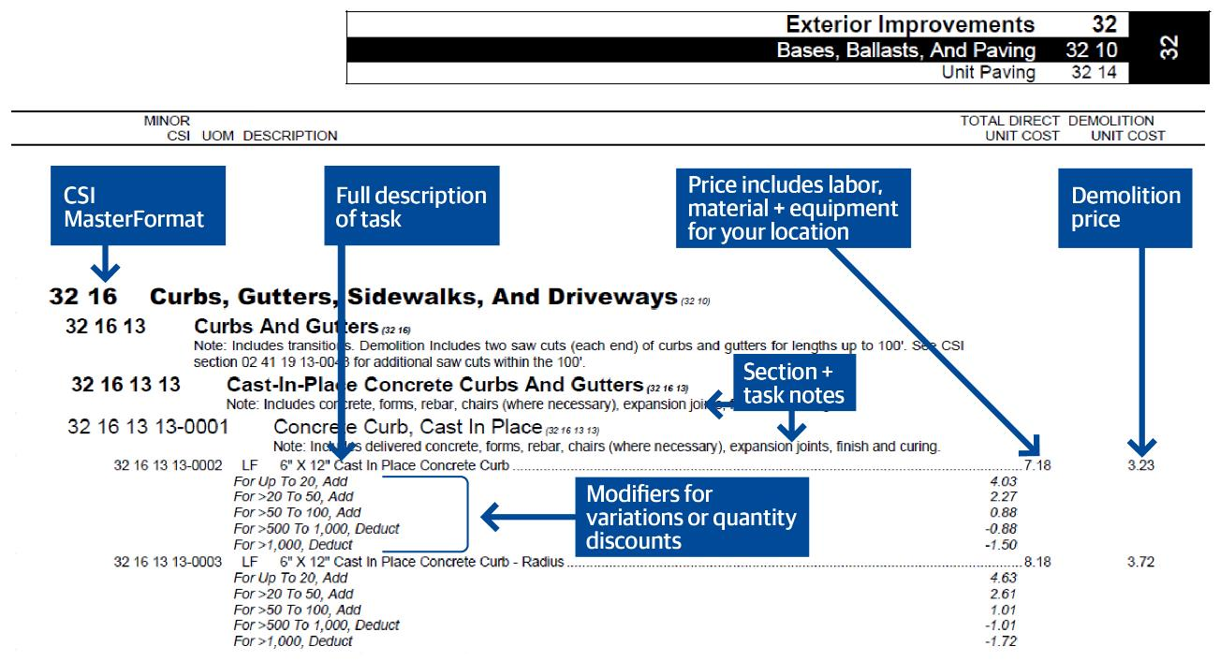
The Contract Documents:
Construction Task Catalog®

Slide 16
The Contract Documents:
Construction Task Catalog®
Understanding the Construction Task Catalog®: Include All Appropriate Tasks in Sample Projects
Compare these prices
* Sample only

Slide 17
The Contract Documents:
Construction Task Catalog®
Understanding the General Rules of the Construction Task Catalog®:
Unit Prices are for Complete and In-Place Construction
Unit Prices Include Labor, Material and Equipment. Do Not Add Labor to Repointing Task.
Unit Prices Include the Cost of Delivery to Project Site, Unloading, Storage and Handling. Delivery Height is up to 2 ½ Stories
Unit Prices Include Testing, Calibration, Balancing Etc. for New Work
Unit Prices Include all Fasteners, Bolts, Anchors, Adhesives Etc. For New Work
Unit Prices for Tasks Such as Windows, Doors, Frames, Countertops Etc. Include Sealant and Caulk

Slide 18
The Contract Documents:
Construction Task Catalog®
Understanding the General Rules of the Construction Task Catalog®:
Demo Price Includes Loading into Truck or Dumpster.
If Item Demolished as Part of Different Task, It will Not be Paid for Separately
Contractor Paid for Installed Quantities Only. Waste is Included in Unit Price
Assembly Prices take Precedence over Component Pricing
14’ Working Height for All Work Except Masonry
4’ Working Height for Masonry
Dumpsters are a Separate Task

Slide 19
The Contract Documents:
Construction Task Catalog®
Understanding the General Rules of the Construction Task Catalog®: Contractors Never Get Paid Separately For the Following
Moving and Returning Furniture Occupying Less than 55% of Floor Area. For Example, Moving Classroom Furniture to Paint
Labor for Protecting Work in Place. For Example, a Laborer to Stay After a Concrete Pour
Minor Barricades and Signage
Portable Toilet, Field Office, Field Office Equipment for Contractor’s Use
Layout, Site Engineering for the Work Itself

Slide 20
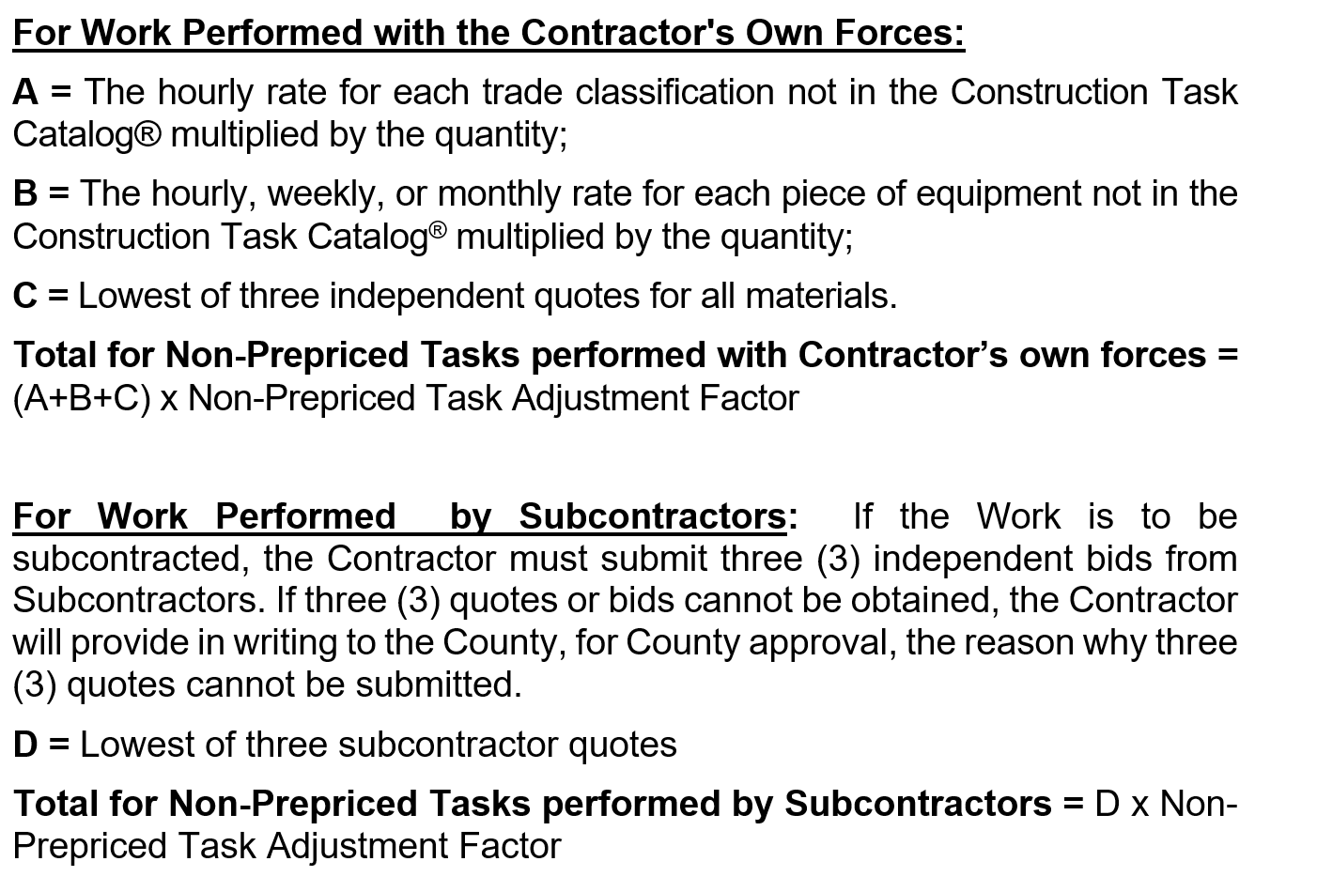
The Contract Documents: Non Pre-Priced Tasks
Contractor must have permission from the County to use a Non Pre-priced Task prior to submission
Three (3) Quotes on vendors’ or subcontractors’ letterhead
Justification for less than three (3) Quotes
Contractor is paid the amount in the following formula:

Slide 21
The Contract Documents
The Technical Specifications
Specifies Quality of Materials and Workmanship
Corresponds with Tasks in the Construction Task Catalog®

Slide 22
Contract Specifics
Prior to Bidding, the County Cannot:
Identify or Commit to any Specific Project or Location
Identify or Commit to any Specific CTC Tasks or Quantities
Contract Specifics Include:
Bidders Must Meet Minimum Requirements Set Forth in Article 5.0
Bid Security = $25,000
Minimum Contract Value = $25,000
Base Term of One (1) Year
Two (2) Additional Terms of One (1) Year Each
Self-Performance Requirement = 51%
Award to (1) or more, with a maximum of (3) Job Order Contracts
Maintain for the duration of the Contract a full service office within a forty (40) mile radius of the Loudoun County Government

Slide 23
Contract Specifics
Payment Bond and Performance Bond
Bonds = $500,000
Differing Site Conditions or Changes in Scope
Priced from Construction Task Catalog®
Supplemental Job Order
No Negotiated Change Orders
Liquidated Damages
Sliding Scale Based on Job Order Price
Filings and Permits
Fees paid for all Permits reimbursed 100% - No Markup

Slide 24
Contract Specifics
Contract award is based on a competitive bid
Bidders must bid (3) Adjustment Factors:
Normal Working Hours: 7:00 am to 5:00 pm Monday to Friday, Except for Holidays
Other Than Normal Working Hours: 5:01 pm to 6:59 am Monday to Friday, and all day Saturday, Sunday and Holidays
Non-Pre-Priced: For Non-Pre-priced Work
The Other than Normal Hours Adjustment Factor must be Greater than the Normal Working Hours Adjustment Factor
Non Pre-priced Adjustment Factor shall not be less than 1.0500 and not higher than 1.2500

Slide 25
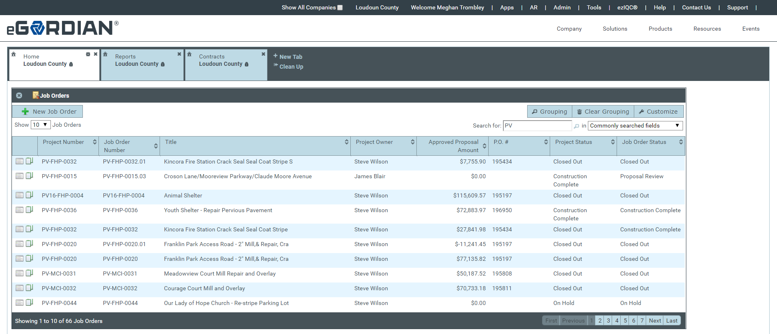
Contract Specifics
Internet Based Software Provided with Contract
eGordian® Software Expedites the Job Order Process
Price Proposals
Subcontractor Lists
Tracking Dates
Required Job Order Forms
Training provided

Slide 26
Contract Specifics
JOC SYSTEM LICENSE FEE
Access to Gordian Cloud, Construction Task Catalog®, other proprietary materials
Most advanced technology and data in the marketplace.
Paperless
Efficient
Tasks and prices input directly... no fishing through old files and estimating books for costs
JOC process training
Gordian Cloud software training
Unlimited software support.
Included in the Contractor’s Adjustment Factors
Consider as an Overhead cost
License Fee Equal to 1% of the Job Order Price

Slide 27
Calculating the Adjustment Factors: Method to Calculate
Use Historical Project Data
Select a Completed Project
You Know Scope and Direct Costs
Price Project From CTC
Add on Overhead and Profit
Calculate the Adjustment Factor

Slide 28
Calculating the Adjustment Factors: Sample Project: Detailed Scope of Work
Interior Renovation
Doors and Hardware
Replace 12 interior doors, hinges and hardware
Doors shall be 3x7, solid core wood doors
Grade 2 locksets with knobs
Replace 2 push bar exist devices and door closers on exit doors
Interior Lighting
Replace all lay-in troffer fixtures on first and second floors. 48 in total
Replace 4 exit fixtures
Replace 12 industrial fixtures in shop area
Plumbing Fixtures
Replace 8 bathroom sinks, 8 faucets, and 8 toilets in men’s and women’s bathroom in admin building and shop area
Replace 4 water fountains
Replace Boiler
Demo existing boiler and as much piping and venting to accommodate new boiler. Install a new 1028 mbh oil fired cast iron boiler. No access for packaged boiler. Must field assemble sections. Provide new piping as required.
Normal Working Hours Apply

Slide 29
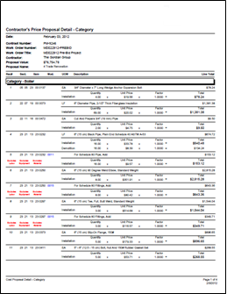
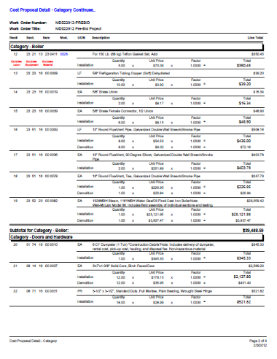
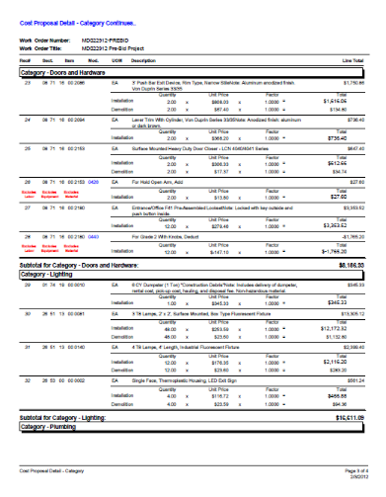
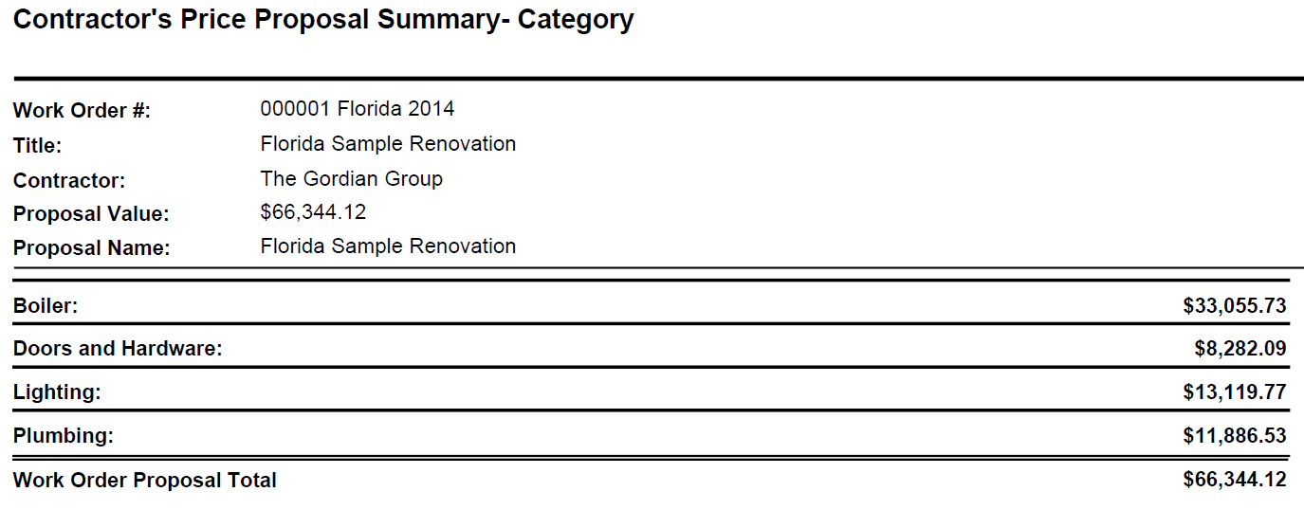
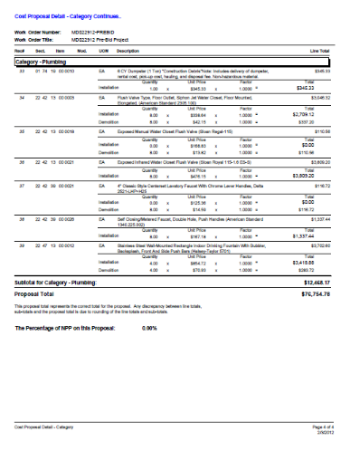
Calculating the Adjustment Factors: Sample Project: Price Proposal

Slide 30
Calculating the Adjustment Factors: Sample Price: CTC vs. Quote
Direct Cost of Work from CTC
Direct Cost of Work from Quotes or Estimates
Replace Boiler $ 33,055.73
Doors/Hardware $ 8,282.09
Lighting $ 13,119.77
Plumbing $ 11,886.53
TOTAL = $ 66,344.12
Replace Boiler $ 34,500.00
Doors/Hardware $ 7,250.00
Lighting $ 12,750.00
Plumbing $ 10,500.00
TOTAL = $ 65,000.00

Slide 31
Calculating the Adjustment Factors: Sample Price: Putting it all together
A. Direct Cost of Work from Quotes $65,000.00
B. Overhead 10%* $ 6,500.00
C. Subtotal (Cost & O/H) $71,500.00
D. Profit 10%* $ 7,150.00
E. Subtotal (Cost & O/H & Profit) $78,650.00
F. Price From CTC $66,344.12
Adjustment Factor (= E / F) = 1.1855
*Sample Only. Contractor to determine O/H & Profit. Prepare this calculation for more than one sample project.

Slide 32
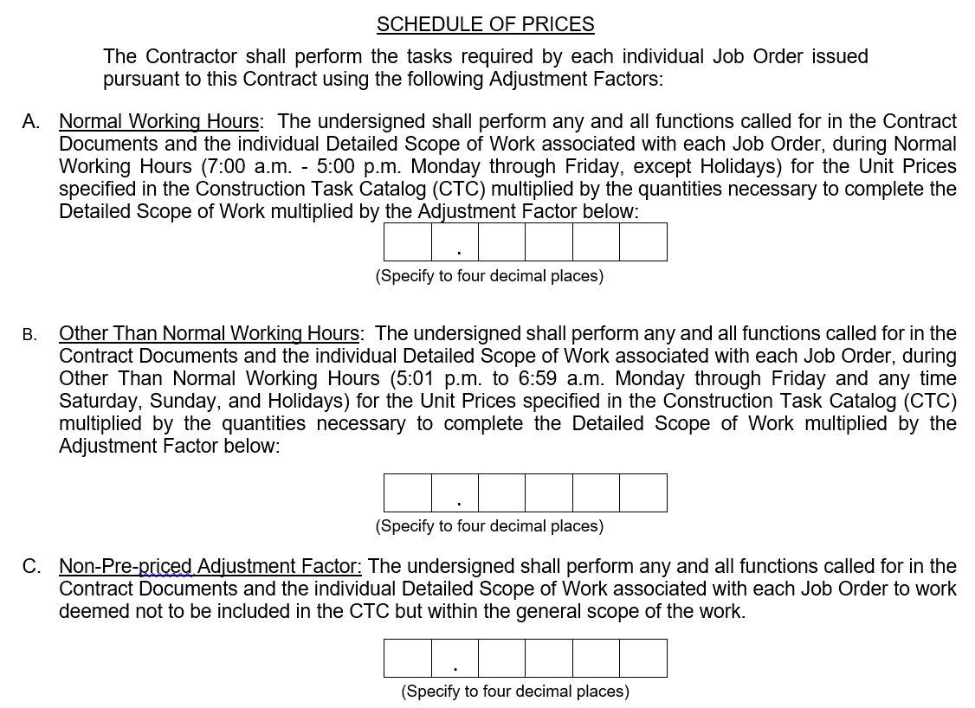
Completing the Bid Form
1 1 7 1 3
1 1 9 6 3
*SAMPLE ONLY
1 1 2 5 0

Slide 33
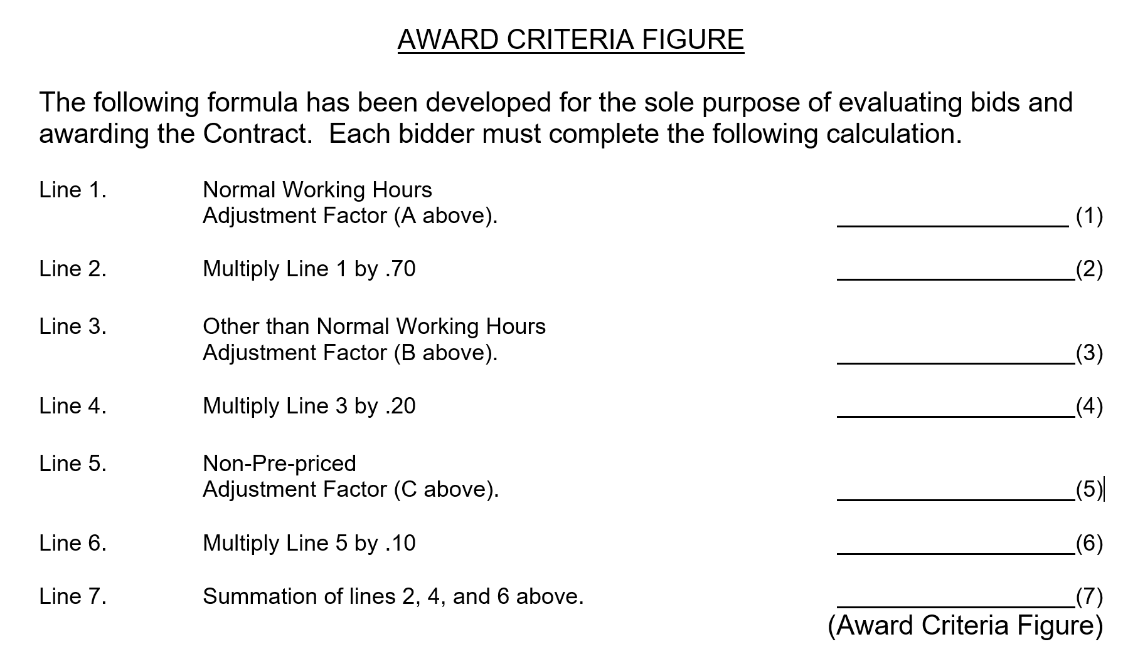
Completing the Bid Form
1 . 1 7 1 3
0 . 8 1 9 9
1 . 1 9 6 3
0 . 2 3 9 2
1 . 1 2 5 0
0 . 1 1 2 5
1 . 1 7 1 6
*SAMPLE ONLY

Slide 34
Completing the Bid Form
1 1 7 1 6
ONE POINT ONE SEVEN ONE SIX
*SAMPLE ONLY

Slide 35
Bid Considerations
Annual Price Adjustment
Applied annually on the anniversary of the Contract Anniversary Award Date
Based on CCI (average of the twenty cities) published by Engineering News Record
Calculation (Based on Month of Solicitation Bid Due Date)
Average CCI for Current Year = The % Increase or Decrease in
Average CCI for Base Year Construction Costs
Percentage x Original Adjustment Factors = New Adjustment Factors for Next Year
Applies to the Both the Normal Working Hours Adjustment Factor and the Other than Normal Working Hours Adjustment Factor
Non-Pre-priced Adjustment Factor Remains Fixed for Duration of the Contract

Slide 36
Considerations
Contractors Should Expect To
Prepare Incidental Drawings or Sketches for Some Projects
Justify Quantity Calculations
Explain Detail of Work
Prepare Proposals for Some Projects That Might be Canceled
Margins on CTC Tasks Vary
Some Projects are More Profitable than Others
Maintain a Fully Functioning Local Office
Hold Required Licenses

Slide 37
Considerations
Importance of Contractor’s Adjustment Factors
Determines Lowest Bidder AND
Used to Price Individual Job Orders
Price Proposal Total Becomes the Lump Sum Job Order Price

Slide 38
Considerations
Risks of Low Adjustment Factors
Leads to Arguments in Proposal Review
Unsupportable Tasks
Exaggerated Quantities
Leads to Delays in Job Order Development
Takes Longer to Review Proposals
Creates an Adversarial Relationship
Reduced Volume of Work
Will Shorten Contract
Lost Profitability
No Second Chance to Improve your Margin

Slide 39
Review of Key Points
Focus on Total Potential Value of Contract
Potential Three (3) Year Contract
Evaluate Construction Task Catalog®
Analyze Unit Prices
Know the General Guidelines for Using the CTC
Contractor Performance Drives Volume
Ability to Market Program and Services
Responsive Service
Accurate Proposals
Safe and Clean Project Sites
High Quality Construction
On-Time Completion & Close Out

Slide 40
Bid Submission

Slide 41
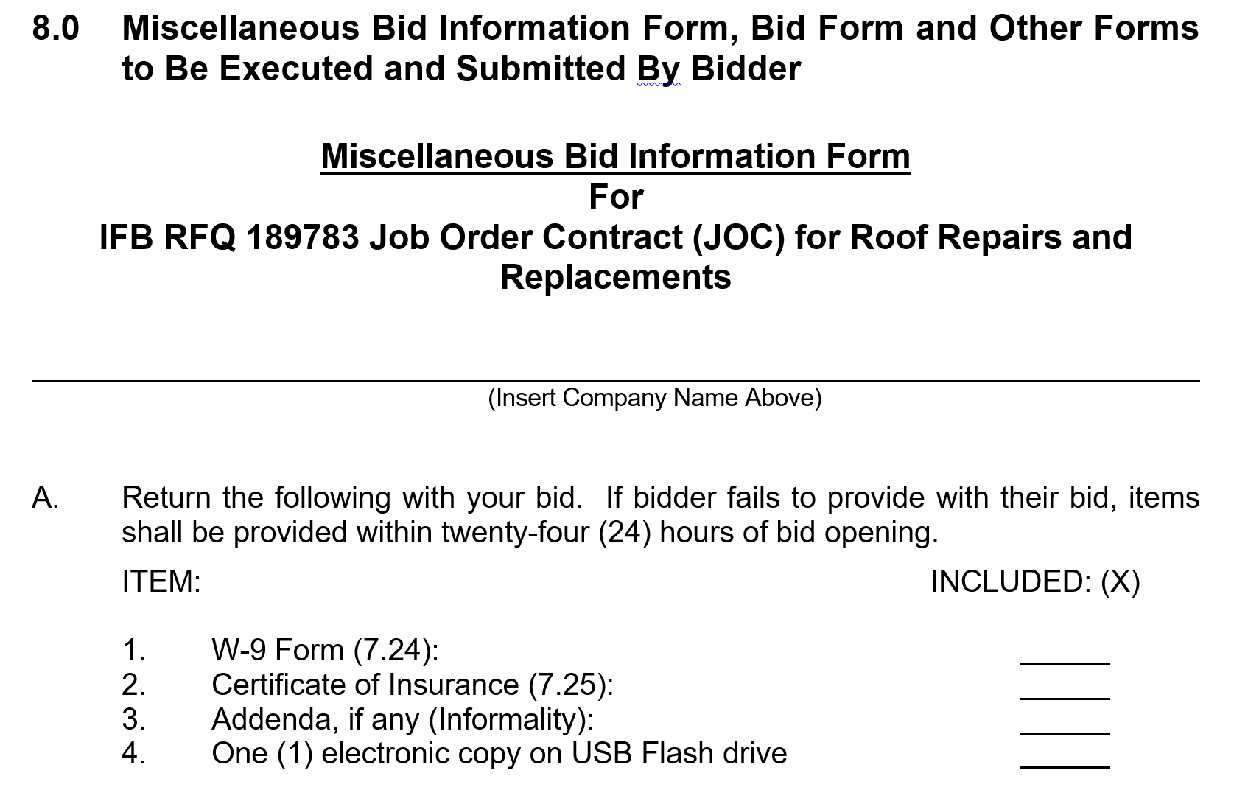
Bid Submission

Slide 42
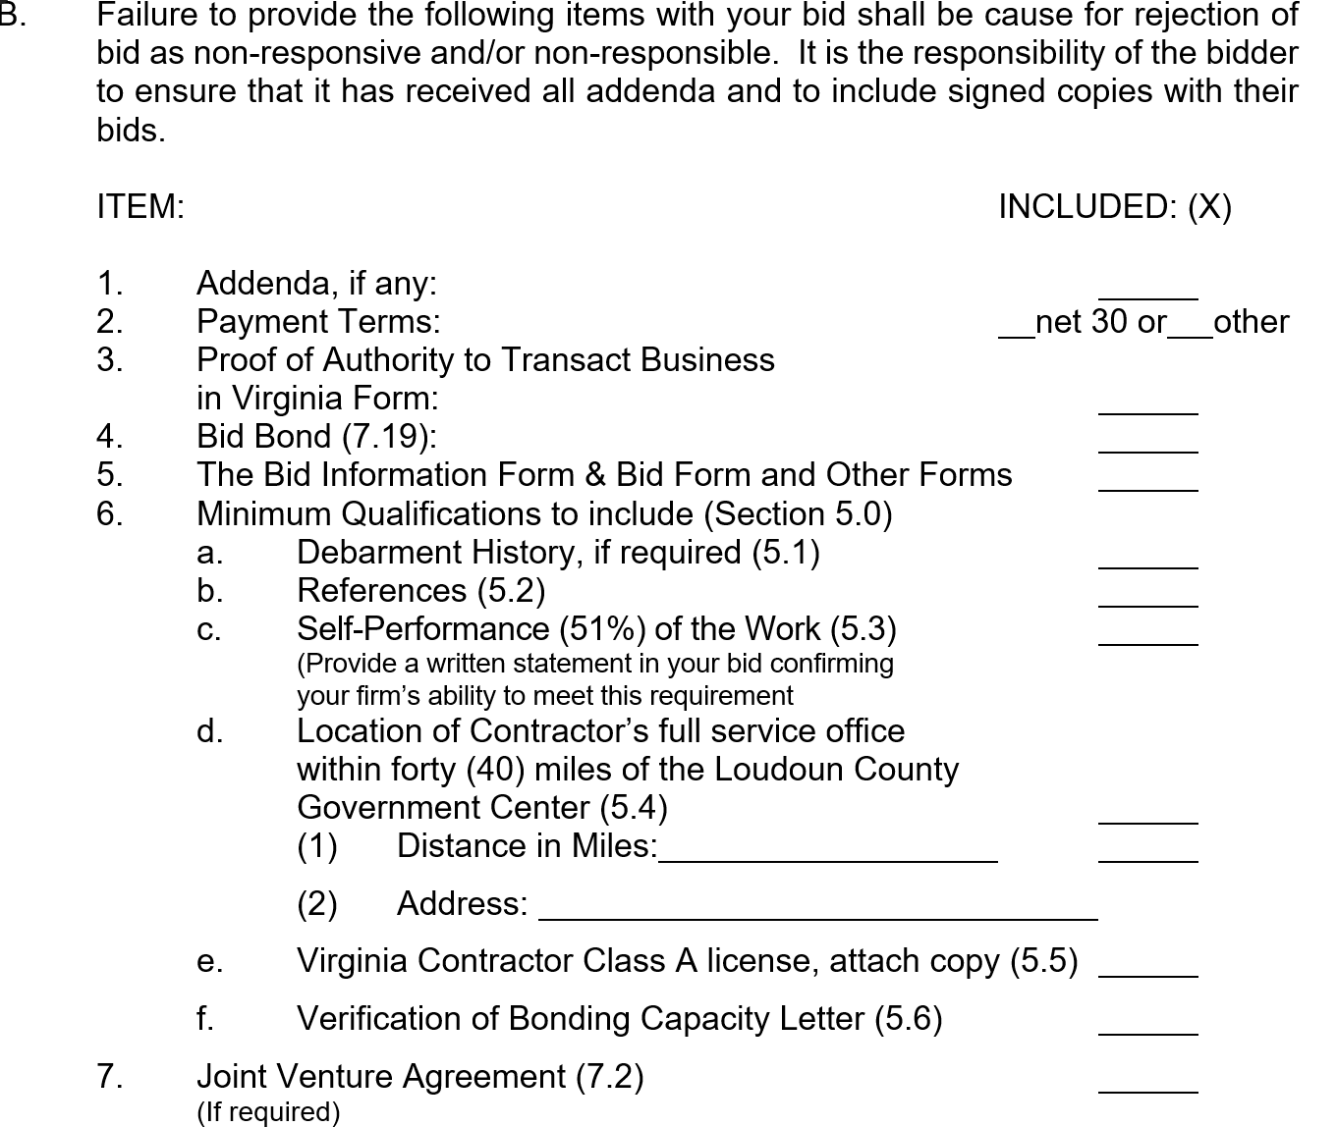
Bid Submission

Slide 43
Bid Submission:
Mailing Address:
County of Loudoun
Virginia Division of Procurement
PO Box 7000
Leesburg, Virginia 20177-7000
Hand Delivery Address:
Department of Finance and Budget
Division of Procurement
1 Harrison Street, S.E., 4th Floor
Leesburg, Virginia 20175
Bids due:
March 12, 2020 no later than 4:00 PM Local Atomic Time

